Slide 1





TaXonTableTools tutorial
Version 1.0
Till-Hendrik Macher

Slide 2


TaXonTableTools tutorial
Download the tutorial dataset:
https://github.com/thm93/TaxonTableTools
Tutorial data:
Macrozoobenthos kick-samples from 4 streams Germany
DNA-metabarcoding data
Read table, produced with JAMP (https://github.com/VascoElbrecht/JAMP)
Taxonomy table, produced with BOLDigger (Buchner & Leese, in review)
12 samples
5 locations
Till-Hendrik Macher
2

Slide 3
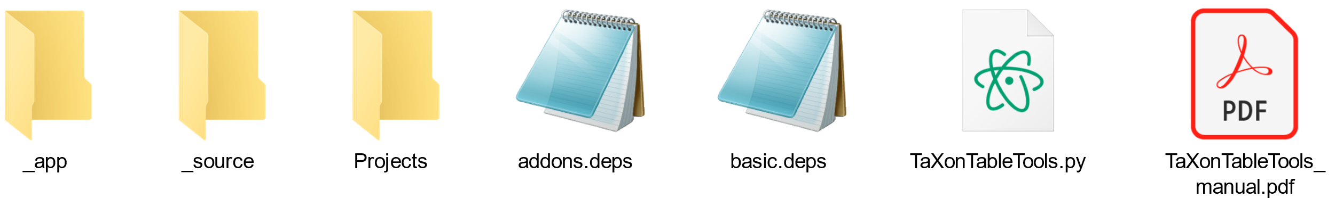
Getting started with TTT
Download TaXonTableTools:
https://github.com/thm93/TaxonTableTools
Installation short guide (see manual for more details):
Unzip TaXonTableTools_versionX.X.zip
Open a console
Change to the TTT folder unzipped previously
$ cd TaXonTableTools_versionX.X
Install dependencies
$ python3.6 –m pip install -r basic.deps
$ python3.6 –m pip install –r addons.deps
Start TTT
$ python3.6 TaXonTableTools.py
Till-Hendrik Macher
3

Slide 4
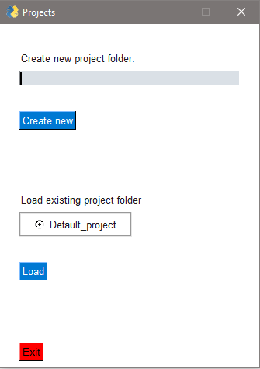
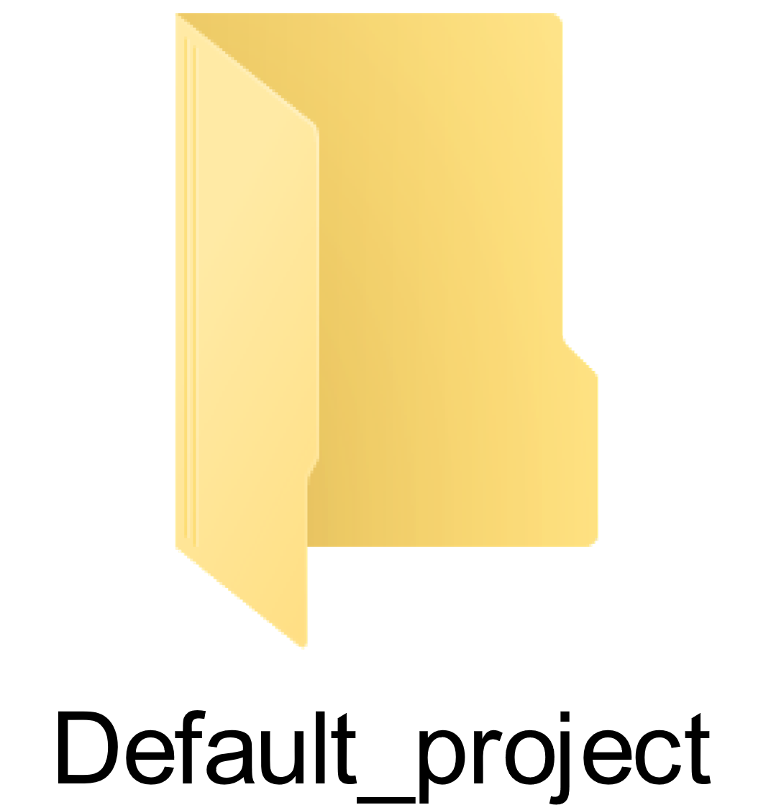
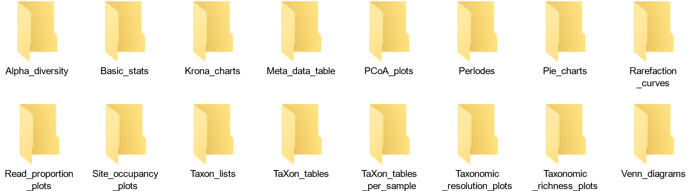
Project management
Create a new project
Project
folders
Output directories
Load a project
folder
Till-Hendrik Macher
4

Slide 5
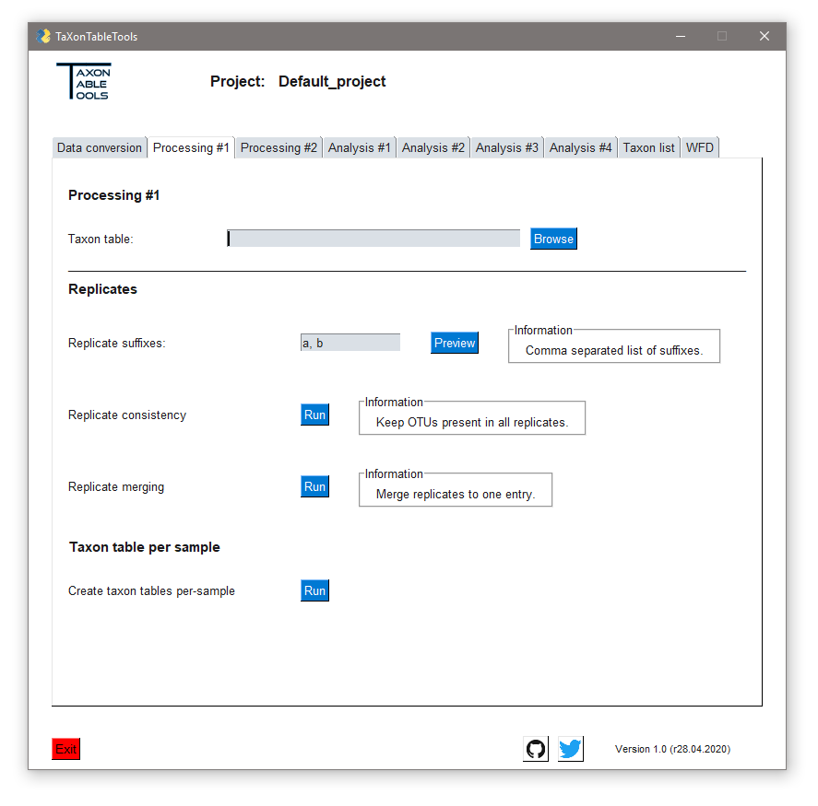
General usage
Displays the active project
All tools are found under specific tabs
TaXon tables are specified for each tab separately
Additional information can be found here
Tools are started via the „Run“ button
Till-Hendrik Macher
5

Slide 6
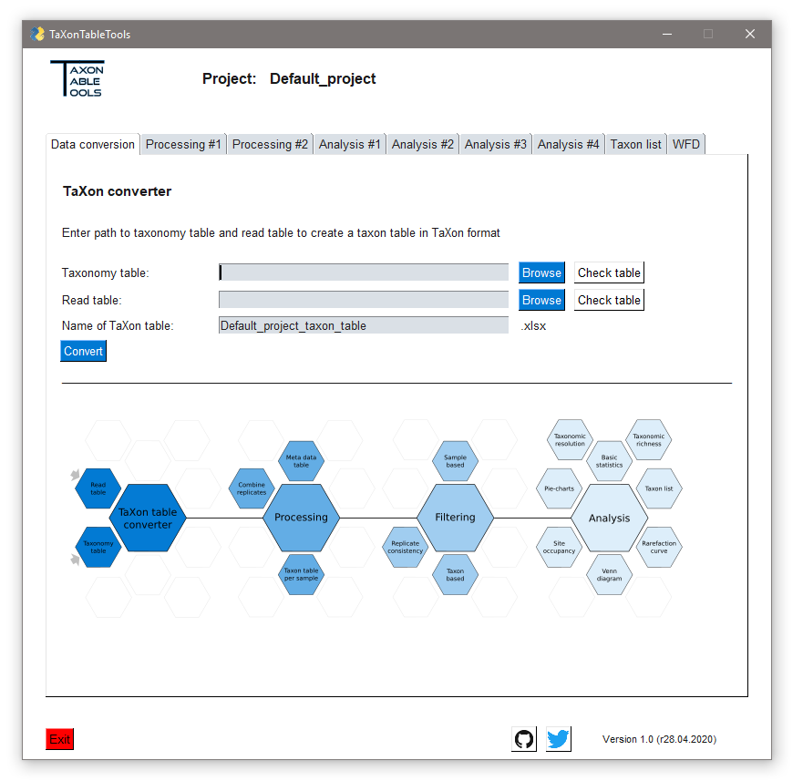

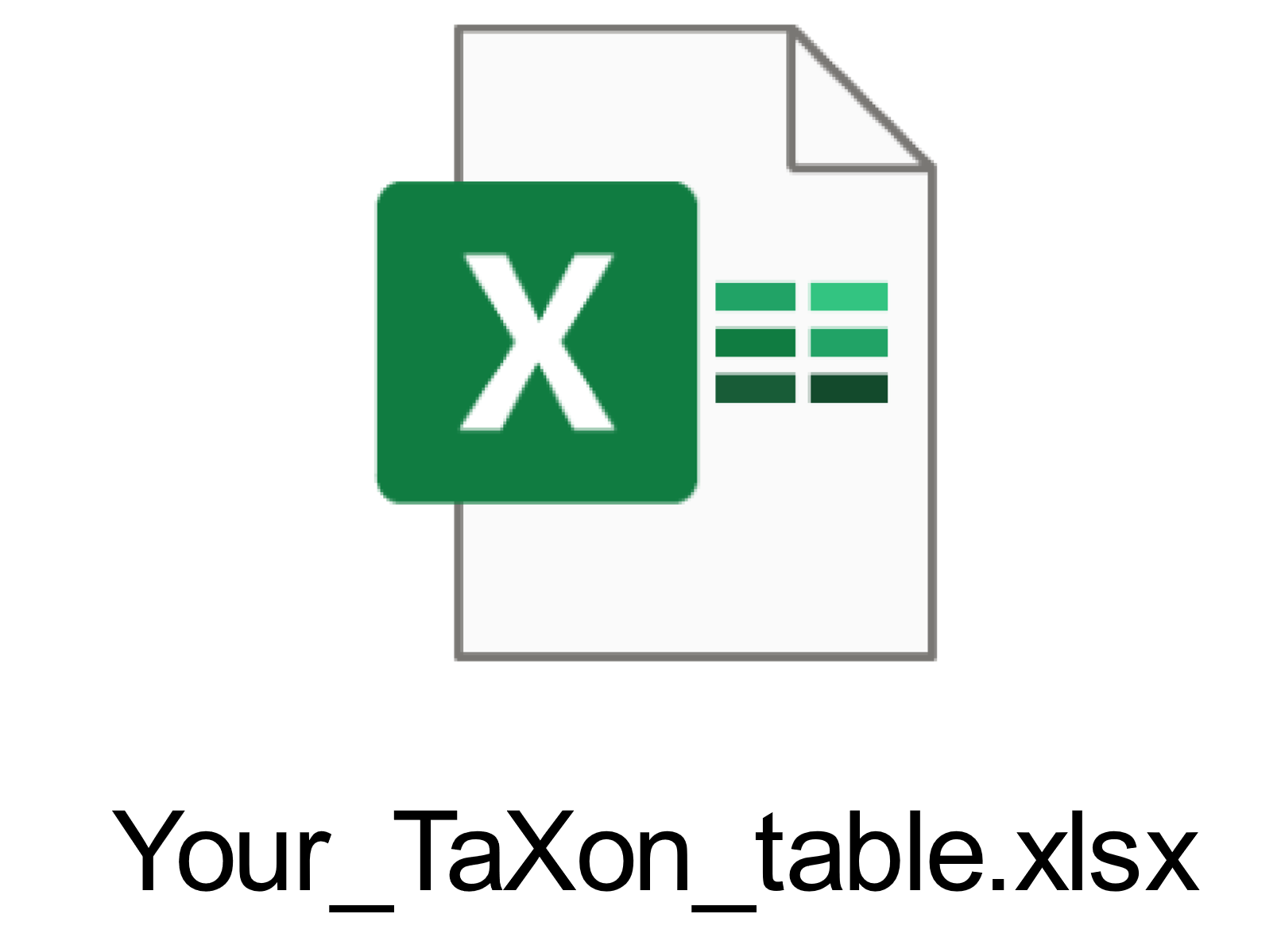
Data conversion
Check tables first!
TaXon table converter:
Browse both tables
Check the taxonomy table format
Check the read table format
Choose a name for the new TaXon table
Tutorial: TTT.xlsx
Convert the tables
Project folder
TaXon table
Till-Hendrik Macher
6

Slide 7
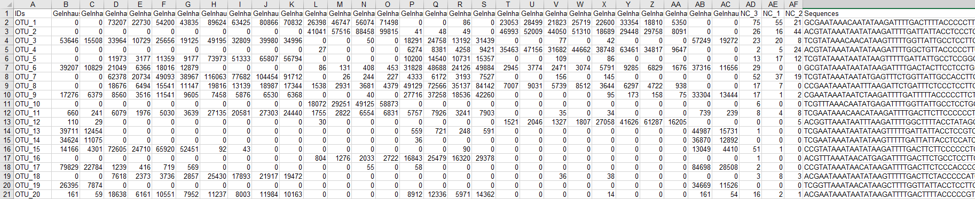
Read table format
IDs = column for OTU names
Sequences = Sequence of each OTU
Sample names
Read abundances
Till-Hendrik Macher
7

Slide 8
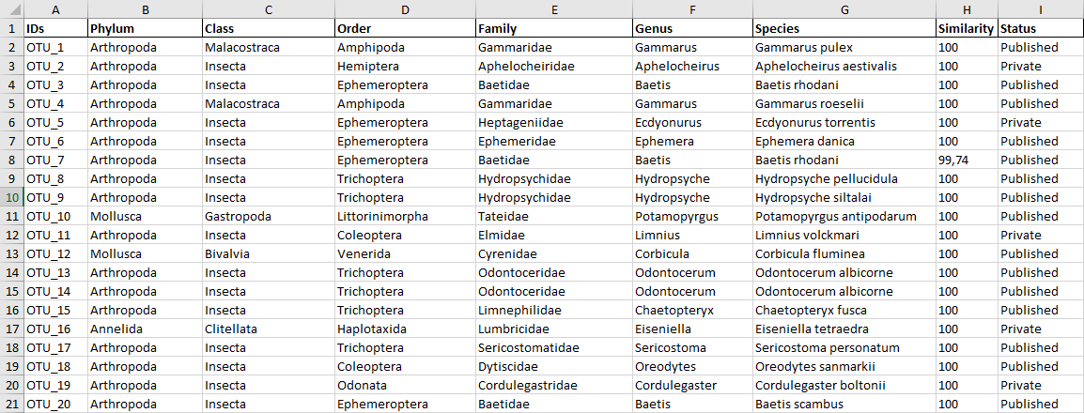
Taxonomy table format
Species name should consist of the genus name and epithet
Taxonomic level column:
Phylum to Species
IDs = column for OTU names
Database status
Database hit similarity
Till-Hendrik Macher
8

Slide 9
Preparing the TaXon table
Replicate consistency
First load the previously created raw TaXon table (TTT.xlsx)
Now type the replicate indicators: _a, _b
Press „Preview“ to show an example
To remove all OTUs that are not present in both samples click the run Run button
A new table named TTT_cons.xlsx was created
Comparing the tables, all OTUs that were not consistent in all samples were set to a read abundance of zero
Till-Hendrik Macher
9

Slide 10
Preparing the TaXon table
Replicate merging
Now load the previously created consistency filtered TaXon table (TTT_cons.xlsx)
Reminder: The active table must be reloaded to work with the latest version
To merge both replicates of all samples press the Run button
A new table named TTT_cons_derep.xlsx was created
Till-Hendrik Macher
10

Slide 11
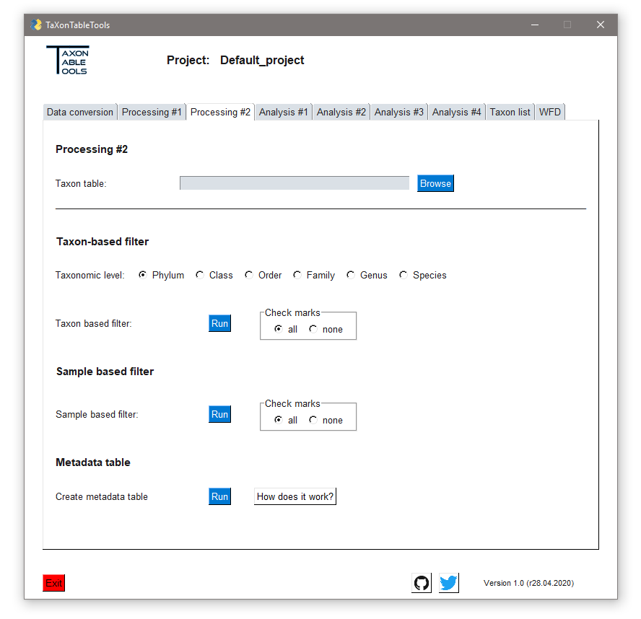
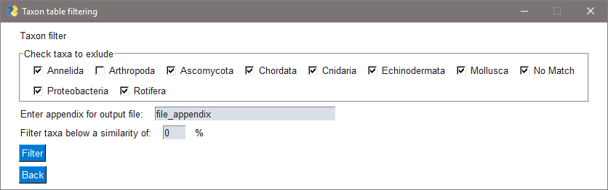
TaXon table filtering
Taxon-based filter
Since there are lots of non-target taxa present in this dataset, we want to focus on just the arthropods
Therefore, load the latest TaXon table (TTT_cons_derep.xlsx)
Leave the check marks option on „all“, as this is the option to go when to exclude a large number of taxa
Click on Run and a new window will pop up
Remove the check mark from „Arthropoda“, enter a new appendix name (e.g. „arthropods“)
Click Filter
A new table named TTT_cons_derep_arthropods.xlsx was created
Till-Hendrik Macher
11

Slide 12
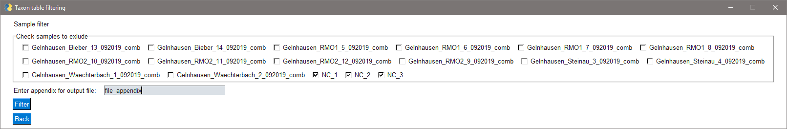
TaXon table filtering
Sample-based filter
Lastly we want to remove the negative controls
Therefore, load the latest TaXon table (TTT_cons_derep_arthropods.xlsx)
Set the check marks option to „none“, as this is the option to go when to exclude a small number of taxa
Click on Run and a new window will pop up
Check all three negative controls and enter a new appendix name (e.g. „no_NC“)
Click Filter
A new table named TTT_cons_derep_arthropods_no_NC.xlsx was created
Till-Hendrik Macher
12

Slide 13
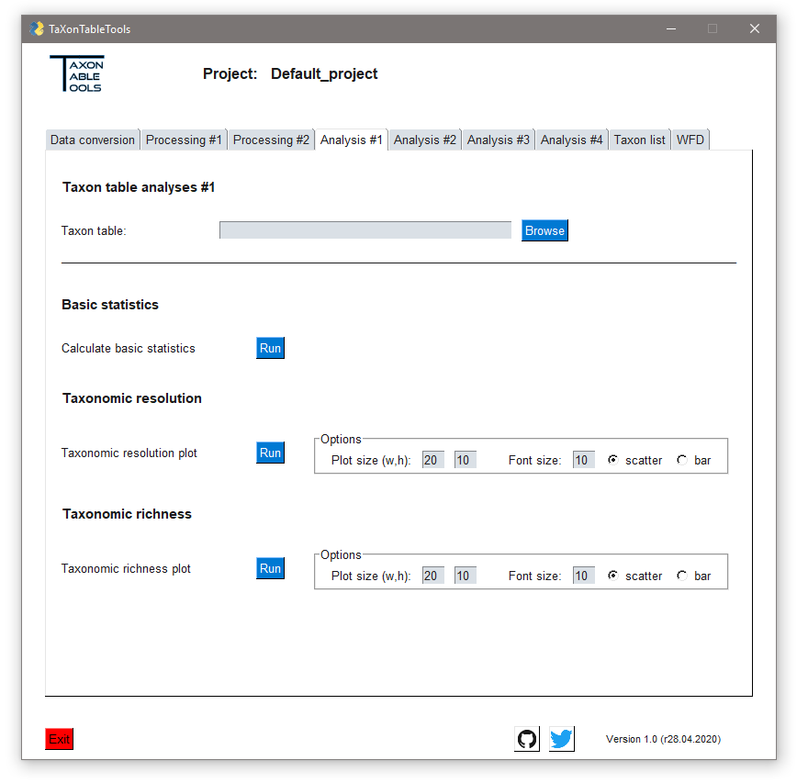
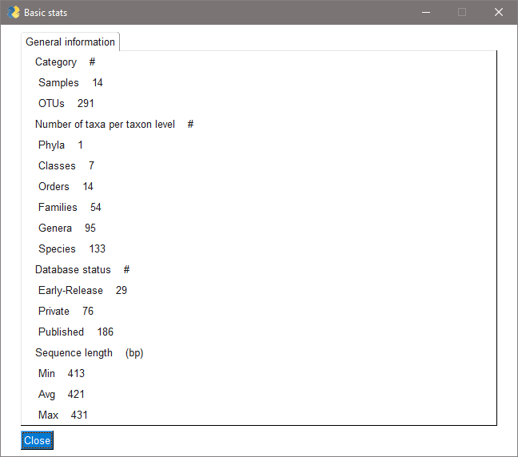
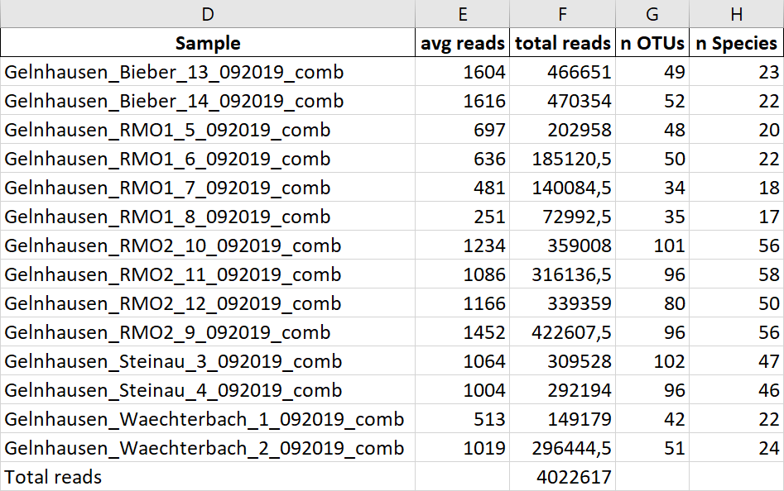
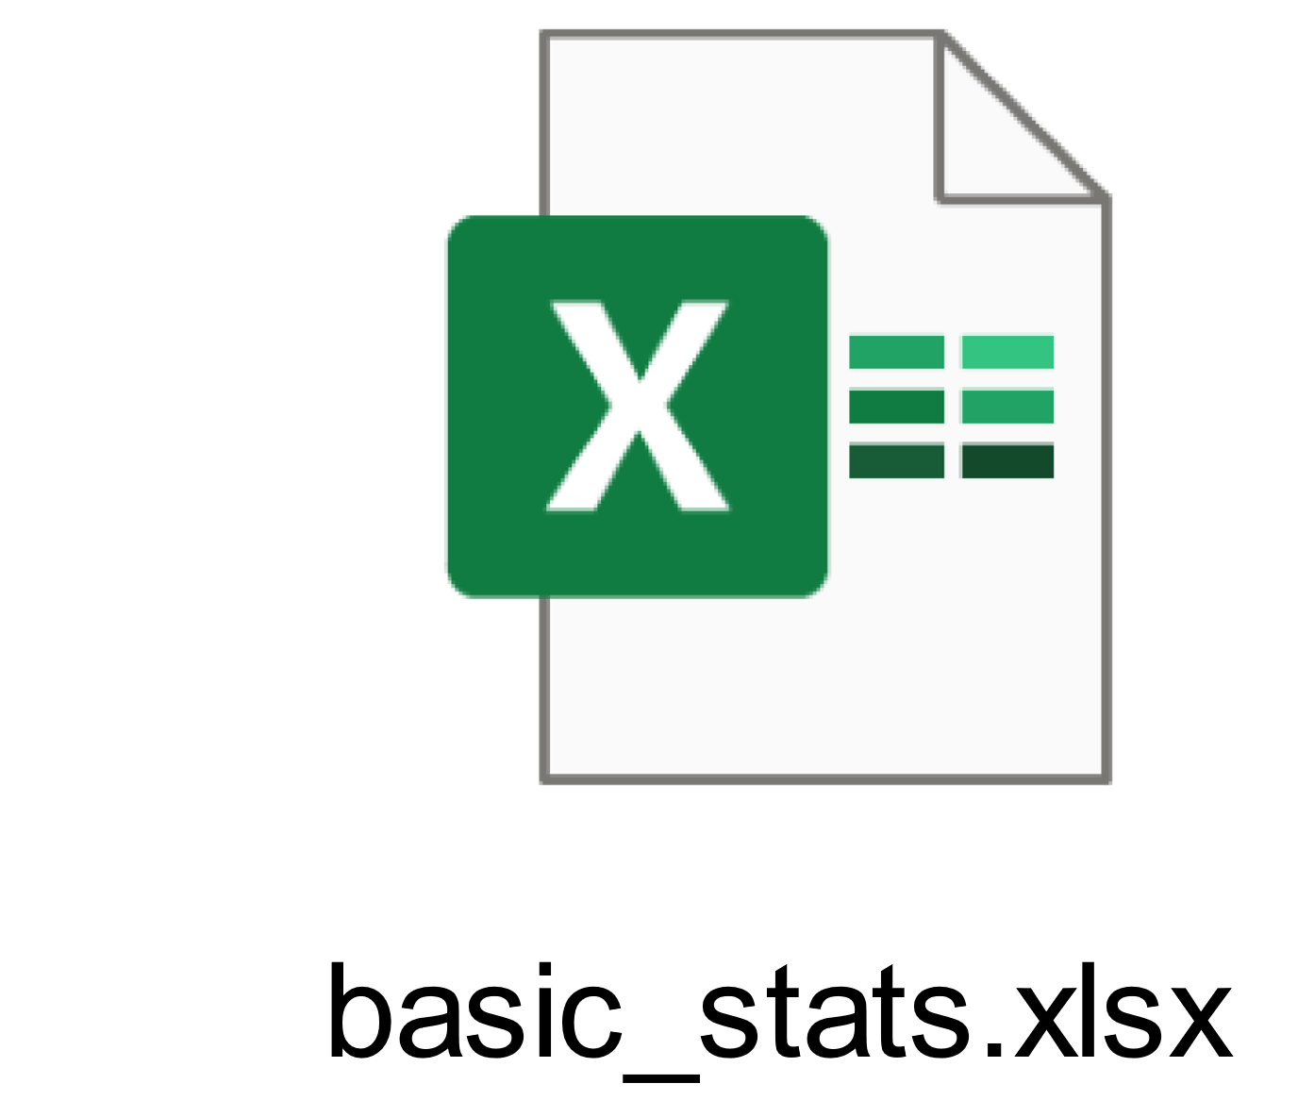
Basic statistics
Load the latest TaXon table (TTT_cons_derep_ arthropods_no_NC.xlsx)
Click on Run
A pop-up with general information will appear
A new table named TTT_cons_derep_arthropods_ _no_NC_basic_stats.xlsx was created
Sample specific informations are found in the Excel file
Statistics table
Till-Hendrik Macher
13

Slide 14
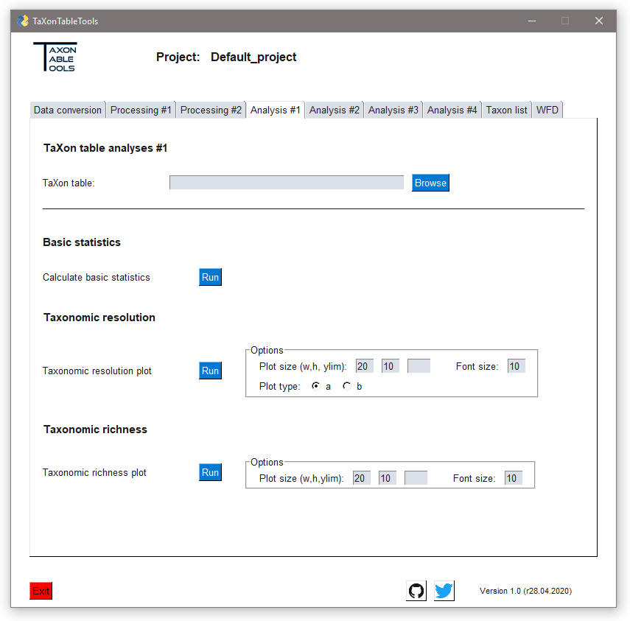
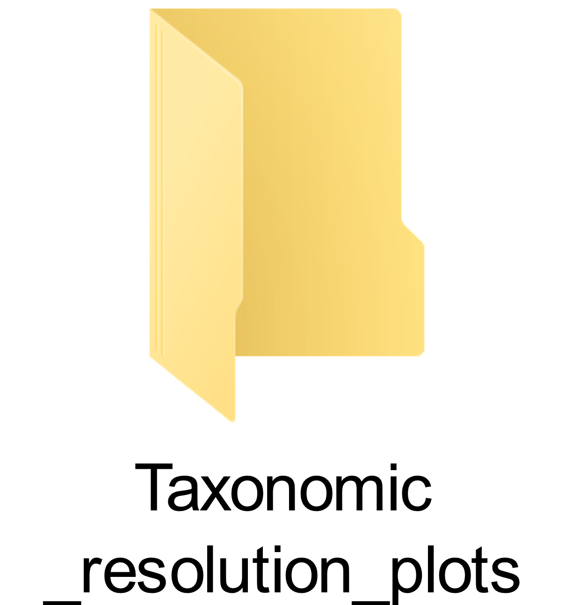

Taxonomic resolution
Load the latest TaXon table (TTT_cons_derep_ arthropods_no_NC.xlsx)
We want the plot to be a square-like bar plot, so adjust the plot width from 20 to 10
Click on Run (repeat for plot type „b“)
A plot preview will pop up. If you are happy with the visuals, click „save“
A new plot was created in the Taxonomic_resolution_plots folder
Taxonomic resolution plot
Project folder
Till-Hendrik Macher
14

Slide 15


Taxonomic richness
Load the latest TaXon table (TTT_cons_derep_ arthropods_no_NC.xlsx)
Again, we want the plot to be a square-like bar plot, so adjust the plot width from 20 to 10
Click on Run
A plot preview will pop up. If you are happy with the visuals, click „save“
A new plot was created in the Taxonomic_richness_plots folder
Taxonomic richness plot
Project folder
Till-Hendrik Macher
15

Slide 16
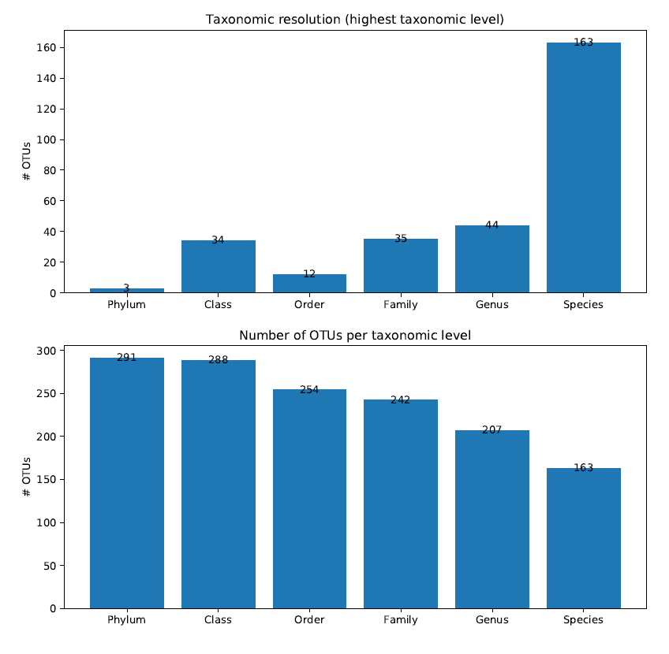
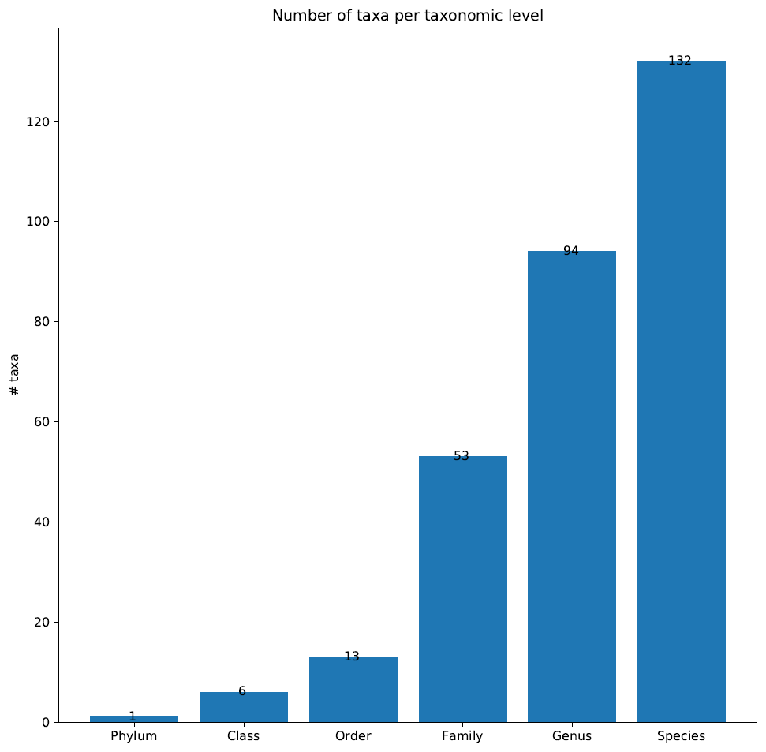
Taxonomic resolution and richness
Type a)
Type b)
Till-Hendrik Macher
16

Slide 17
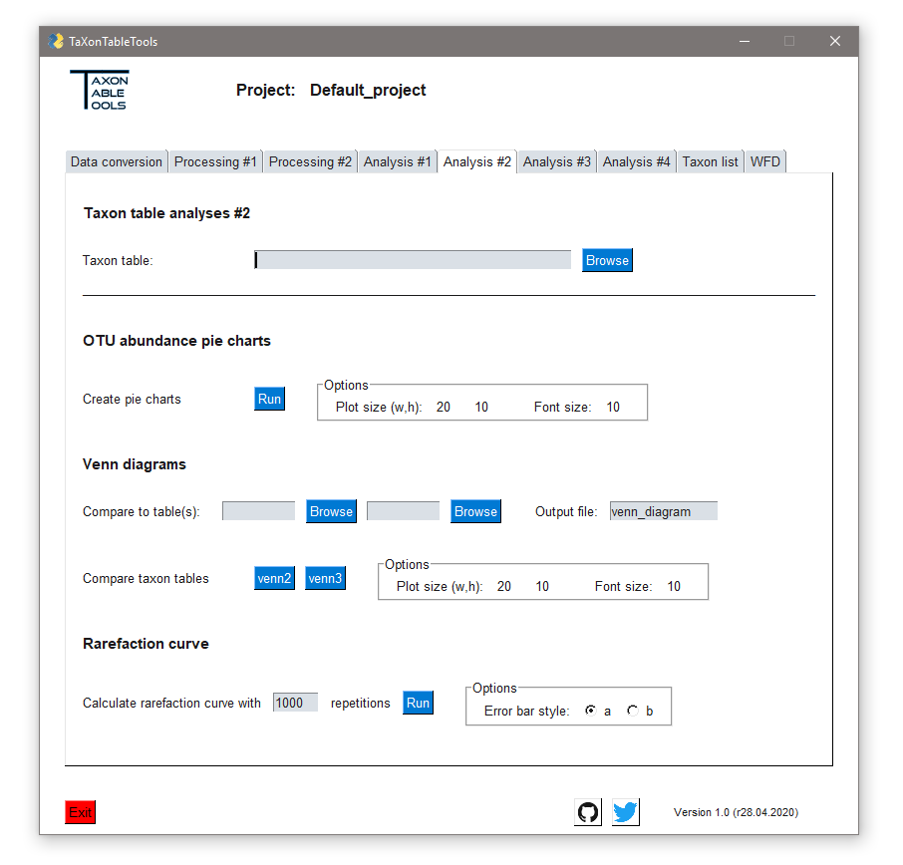

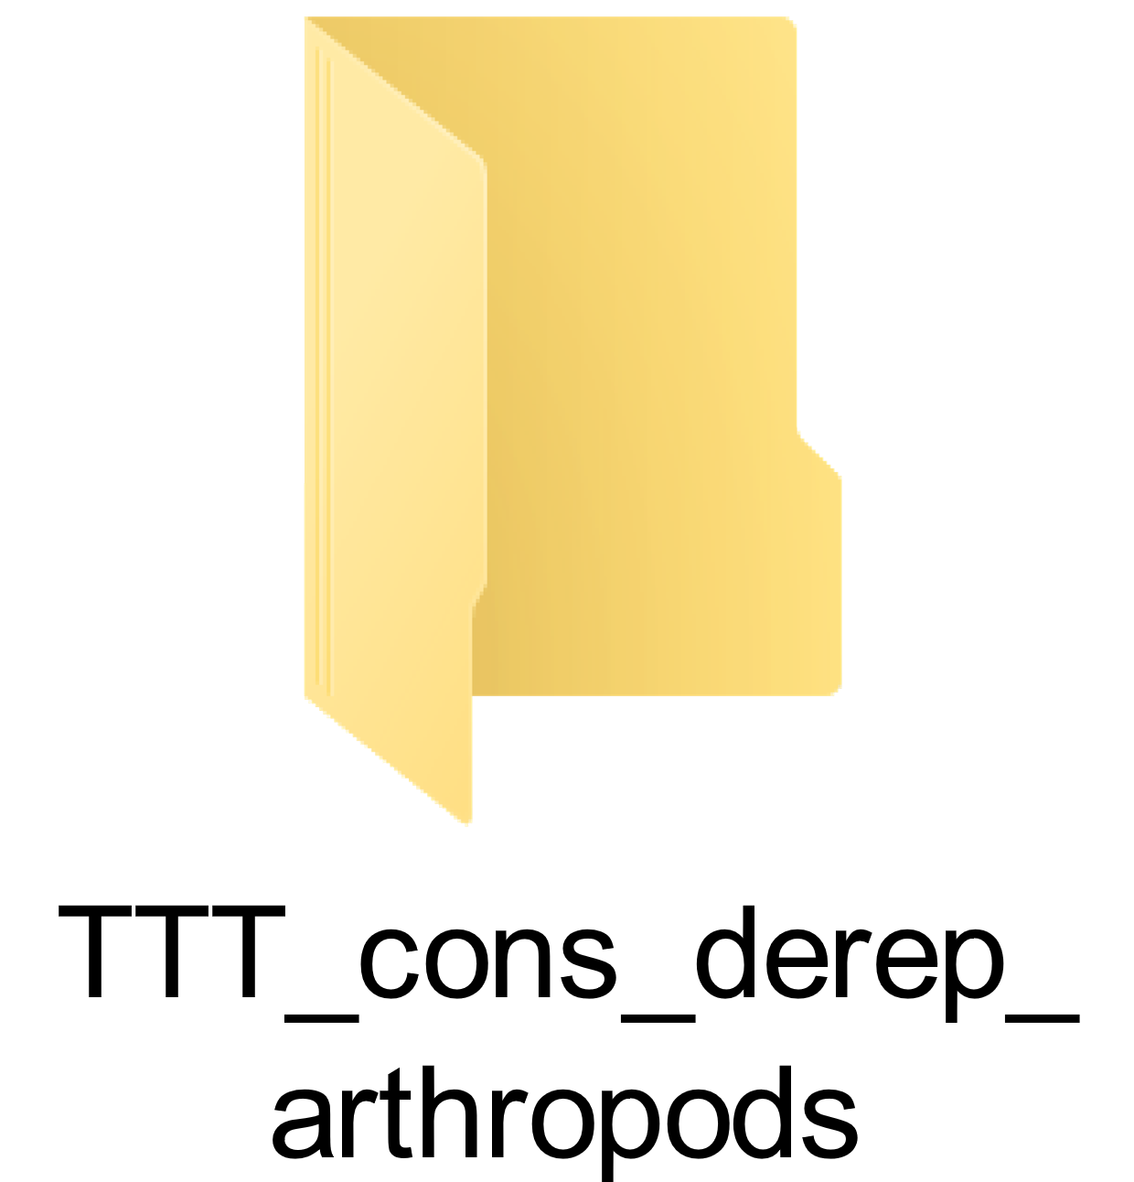

OTU abundance
Pie charts
Load the latest TaXon table (TTT_cons_derep_ arthropods_no_NC.xlsx)
In this case we set the font size to 10
Click on Run
This will calculate 6 different pie charts, from phylum to species level
The plots illustrate the relative number of OTUs for this sample set (not read proportions!)
Now we can adjust the raw plot with any vector manipulation program
OTU pie chart
Till-Hendrik Macher
17

Slide 18
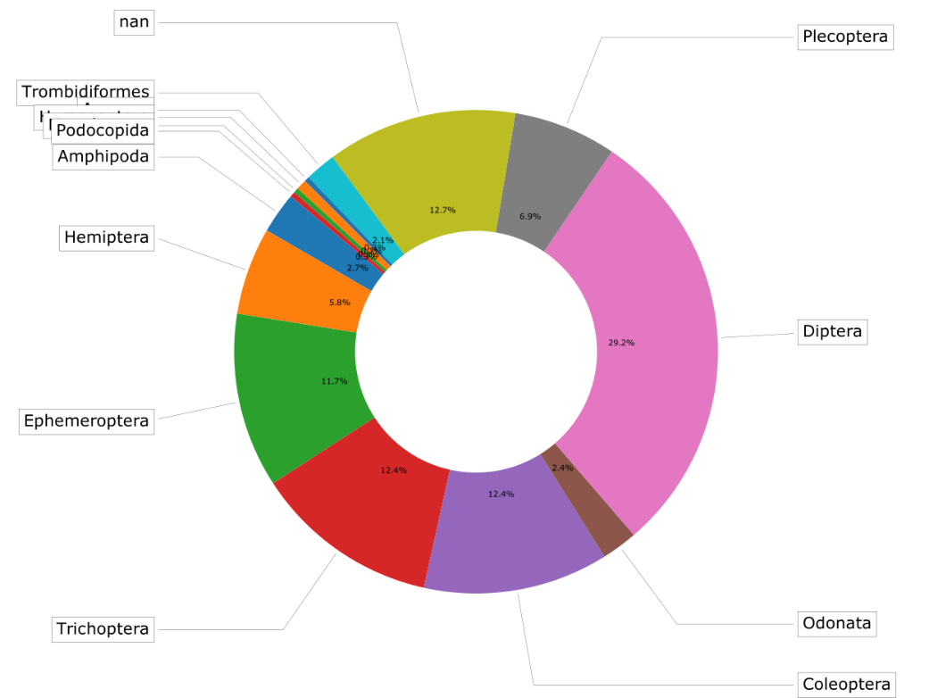
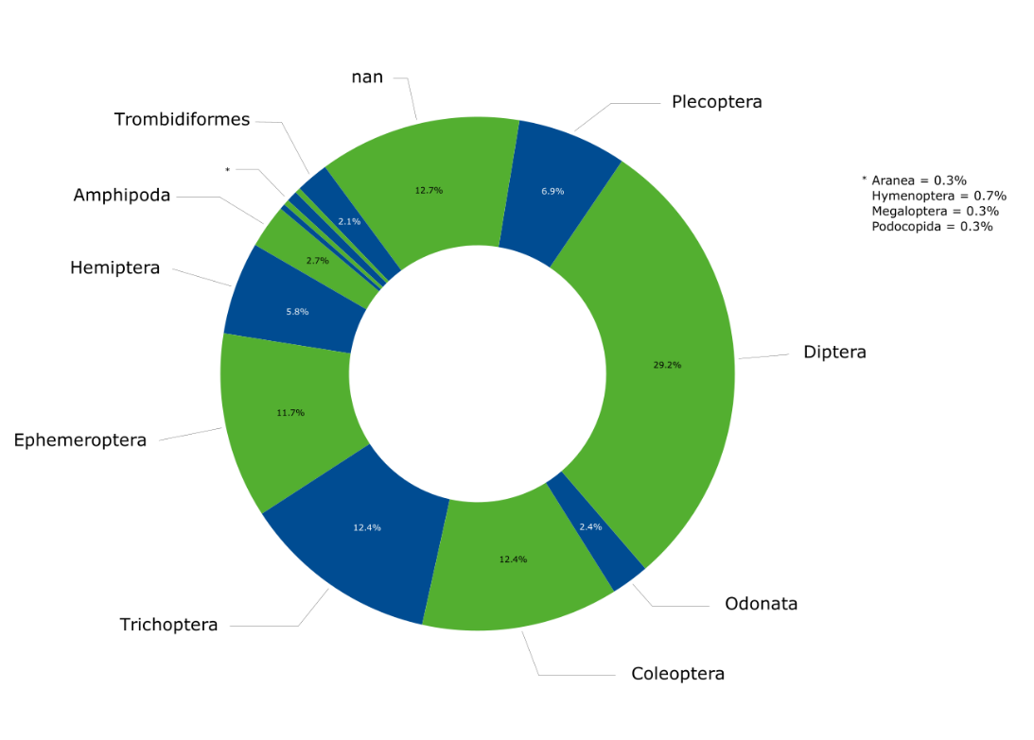
OTU abundance
raw
adjusted
Till-Hendrik Macher
18

Slide 19
Creating sub sets
TaXon table per sample
A first way to compare samples is to create individual TaXon table
To do so go to the 2nd tab and use the TaXon table per sample tool
This will create an individual table for each sample in a new folder
We will use 3 of these to create venn diagrams
TaXon table subset
Alternatively we can create sub sets of the original table using the „sample-based filter“ tool
Till-Hendrik Macher
19

Slide 20
Venn diagrams
Main TaXon table
The tables are ordered as follows:
Main TaXon table
Venn2 TaXon table
Venn3 TaXon table
Venn2
Load the main TaXon table (i.e. Bieber_13)
Load the second TaXon table (i.e. RMO1_5)
Press venn2
Venn3
Load the main TaXon table
Load the second TaXon table
Load the third TaXon table (i.e. Waechterbach_2)
Press venn3
2nd TaXon table
3rd TaXon table
Till-Hendrik Macher
20

Slide 21
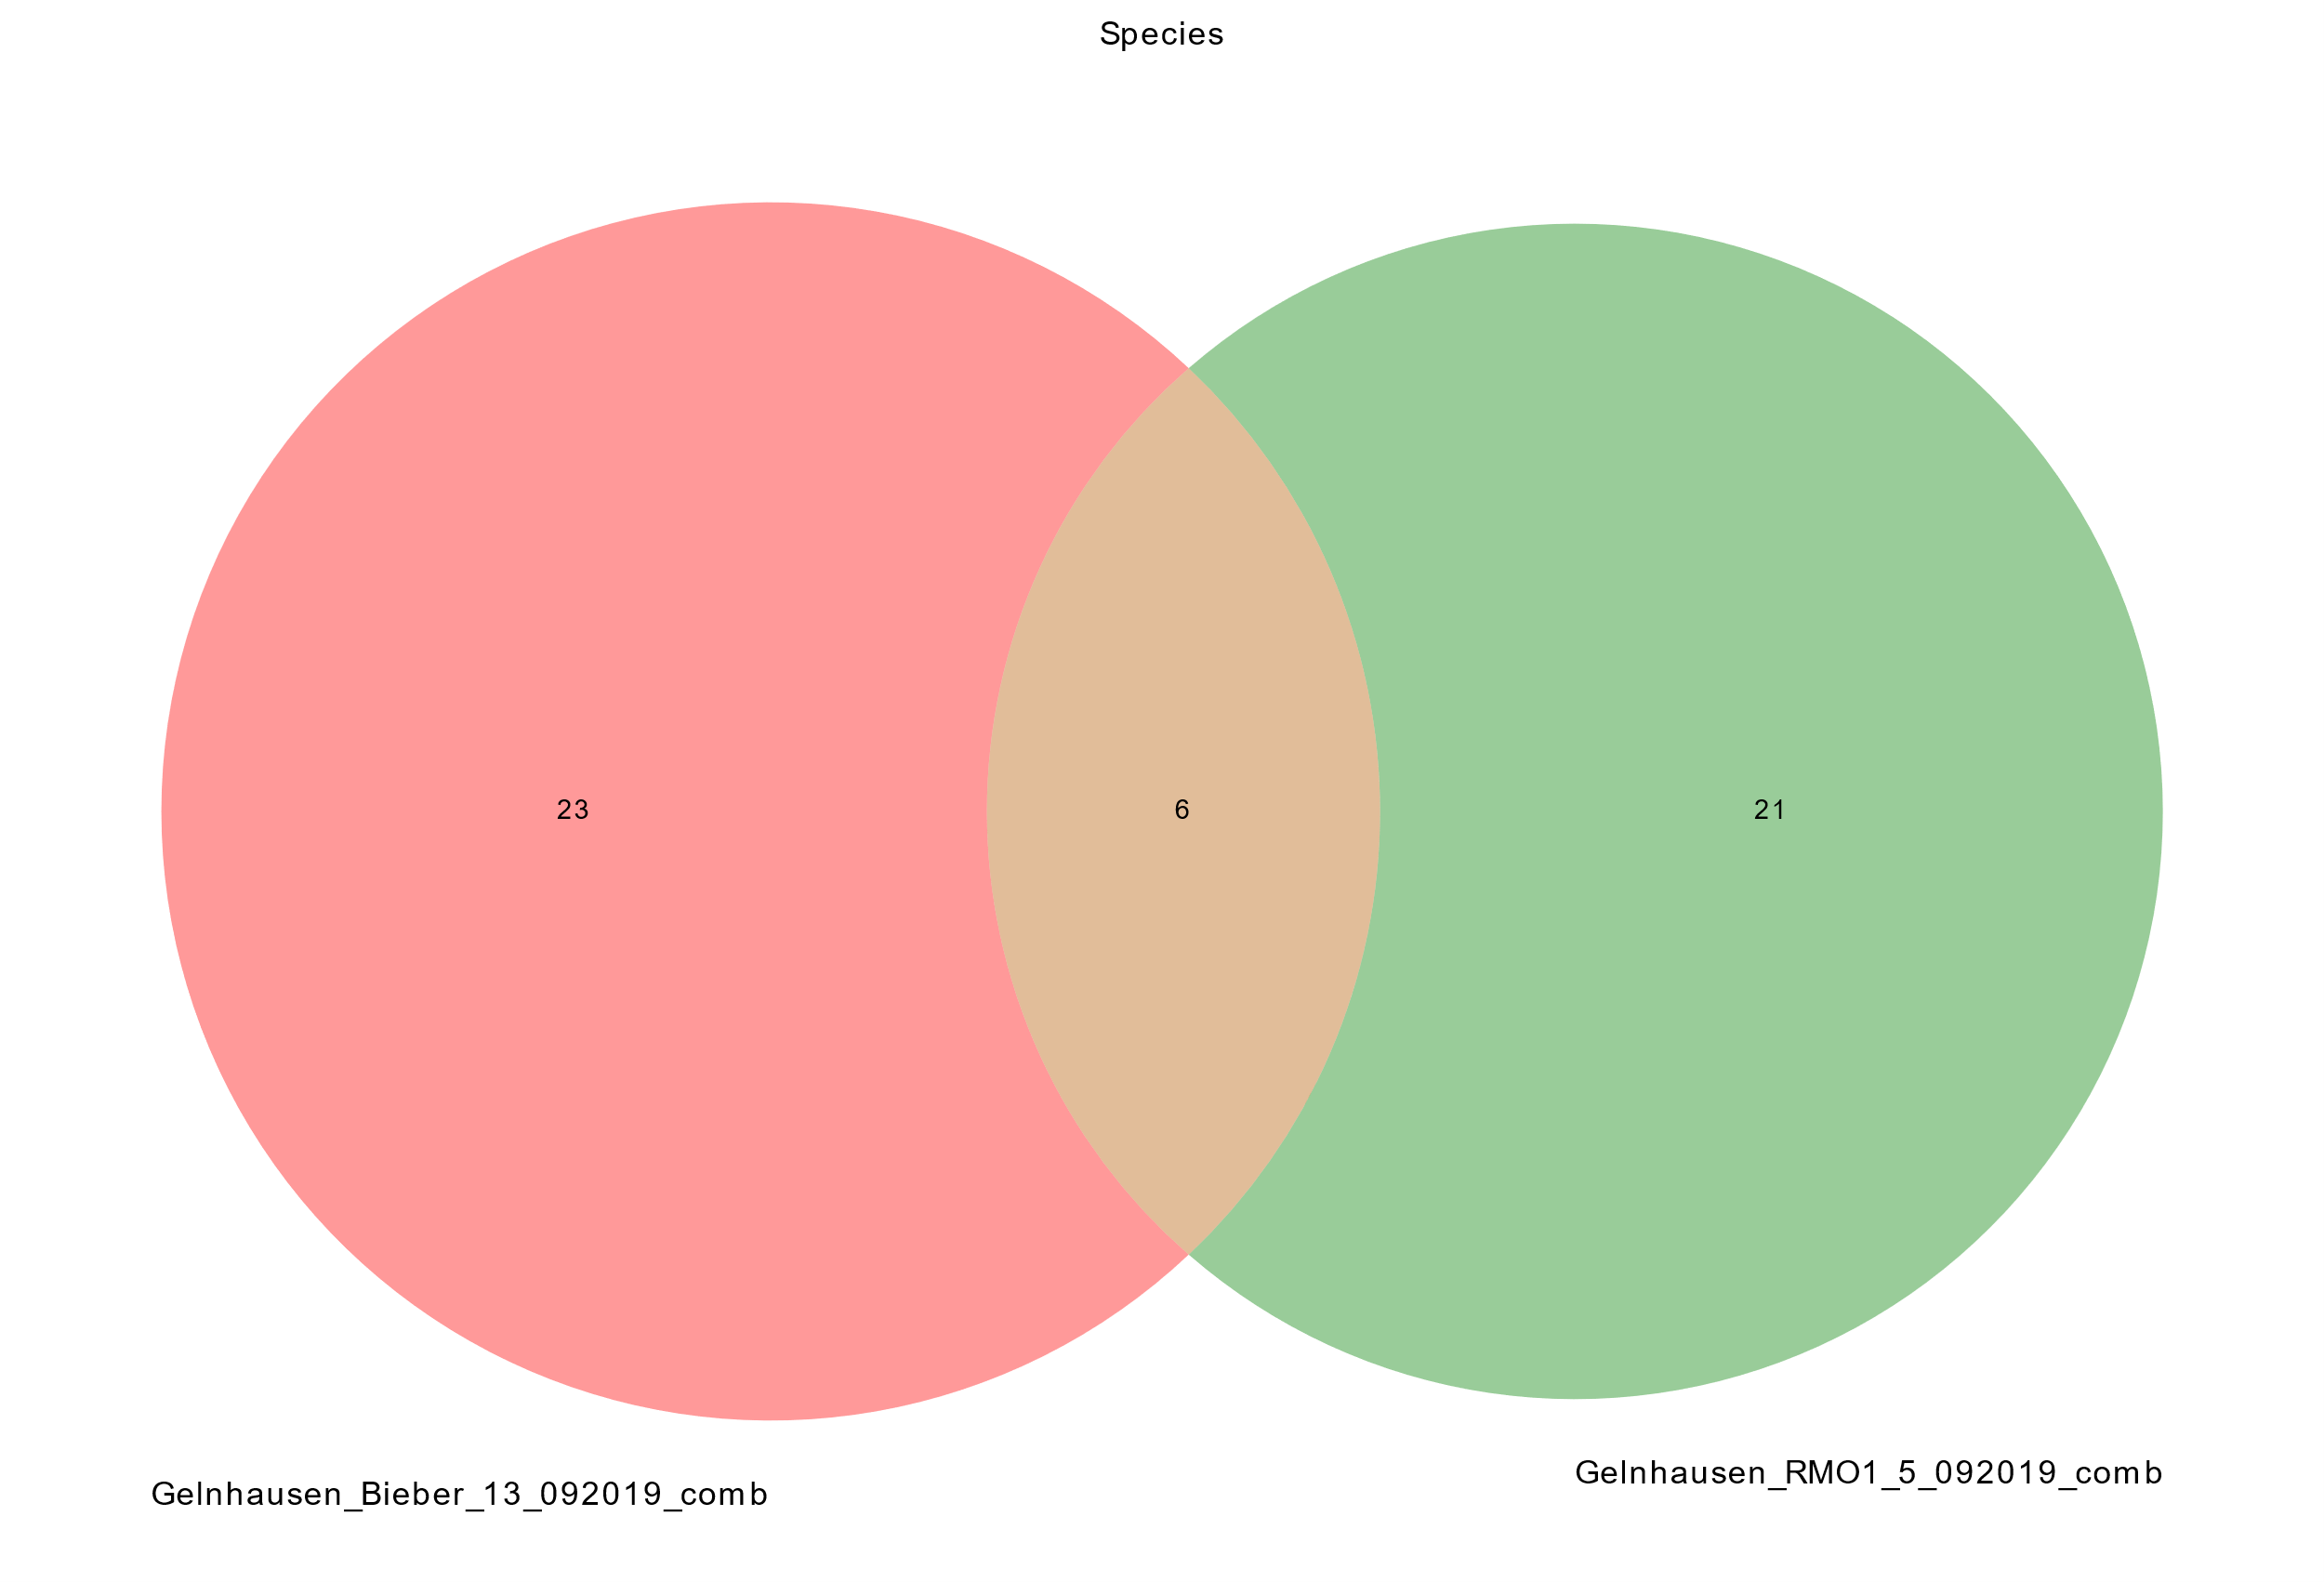
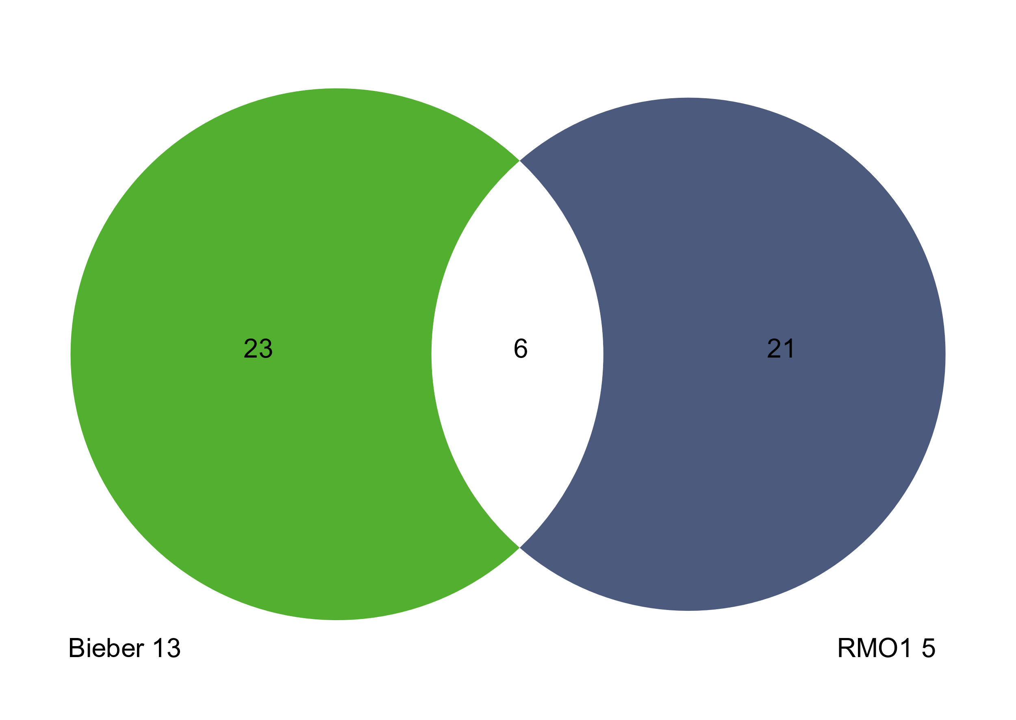
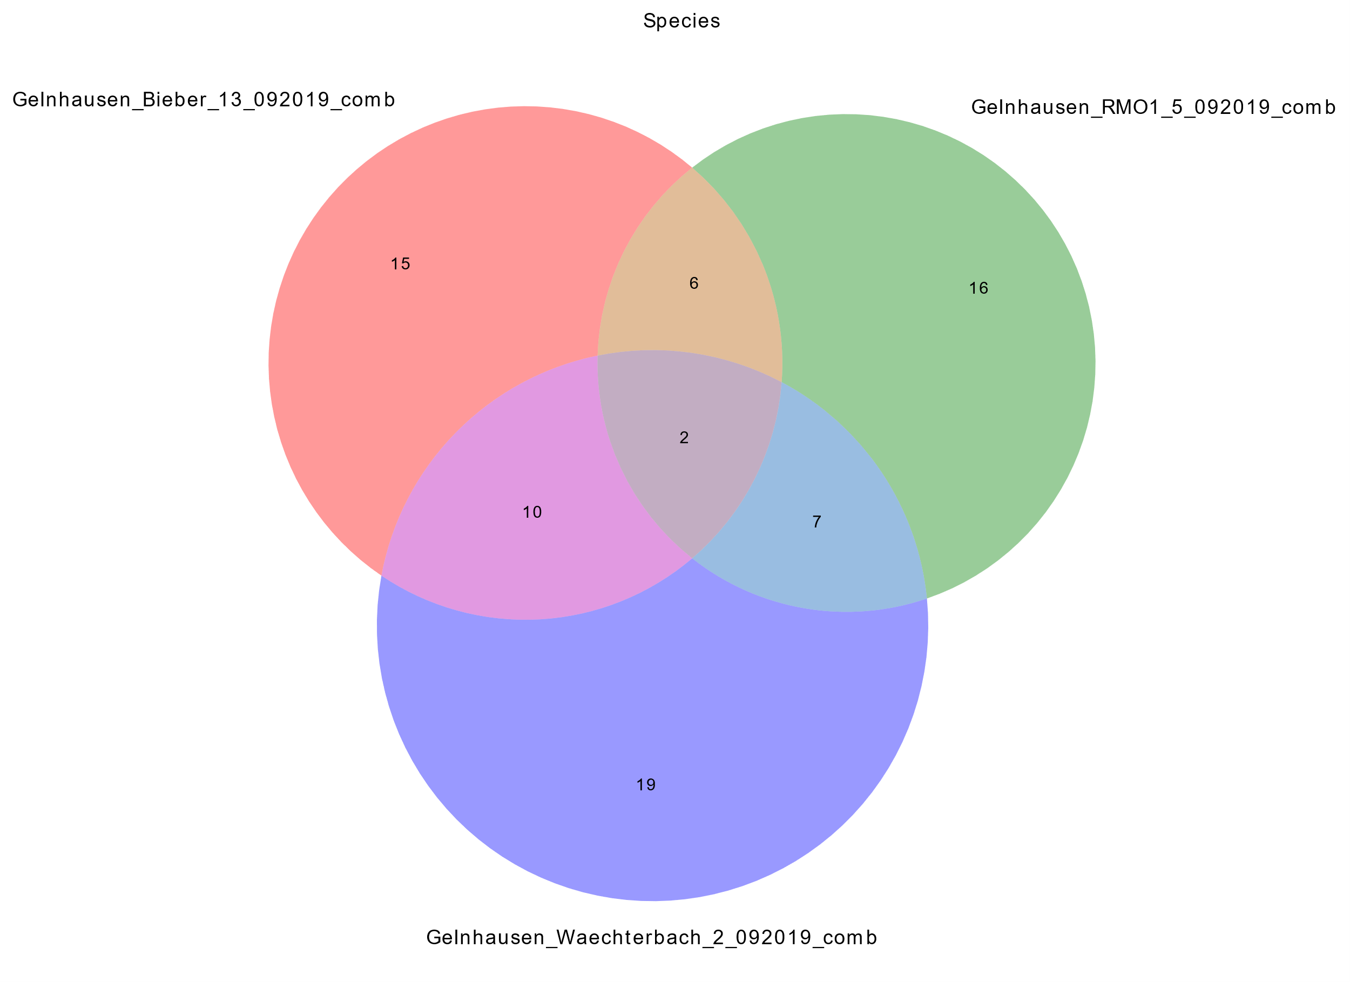
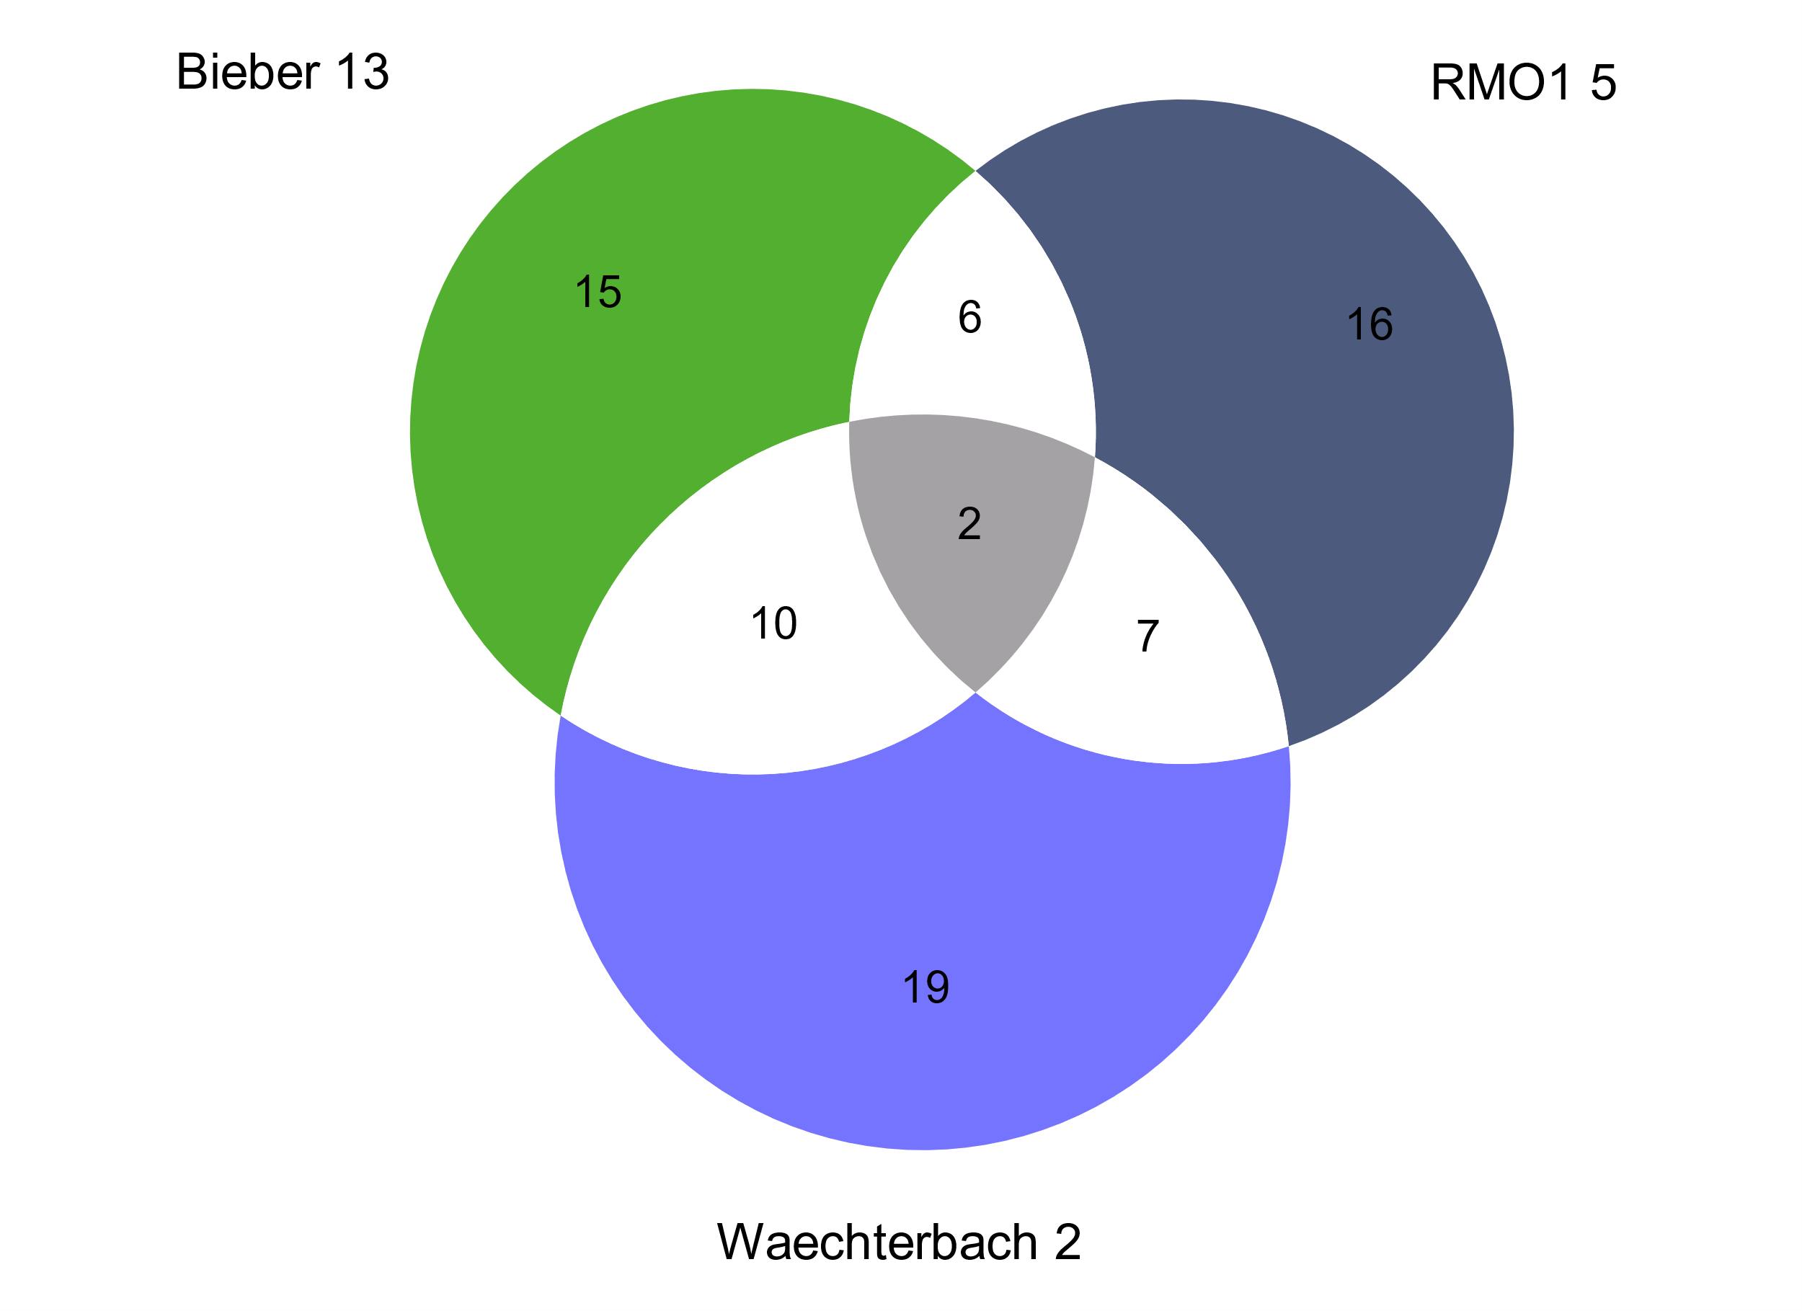
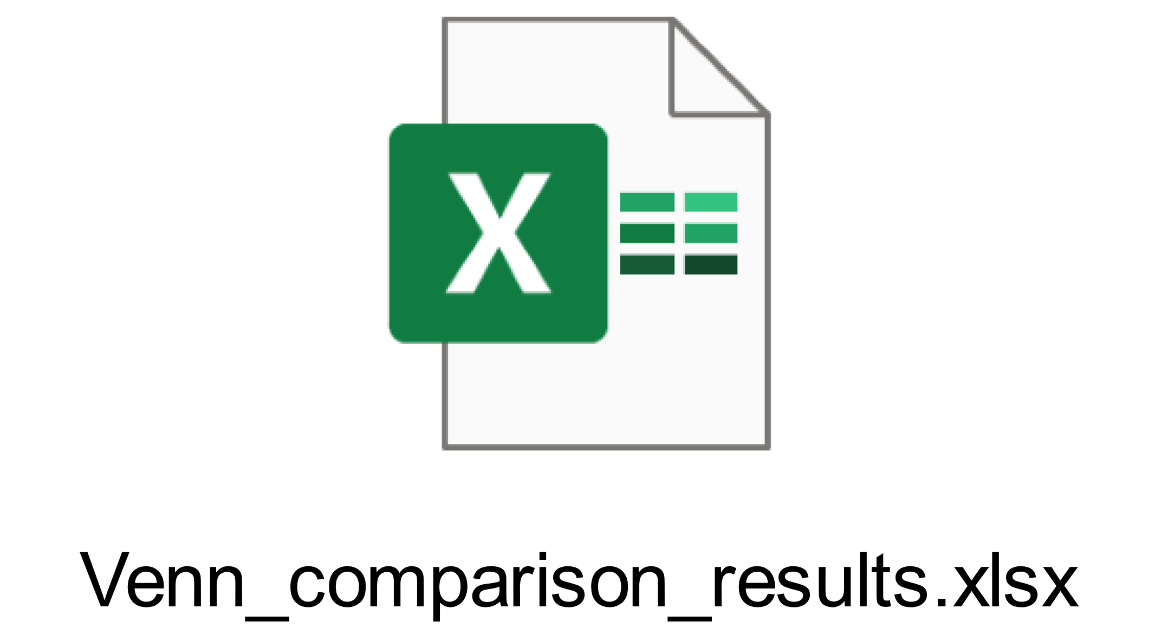
Venn diagrams
6 new plots will be created (from phylum to species level)
Remember to change the name of the plot, it will be overwritten otherwise
Additionally the results will be saved to a new table named „Venn_comparison_results“
Venn diagram table
Till-Hendrik Macher
21

Slide 22
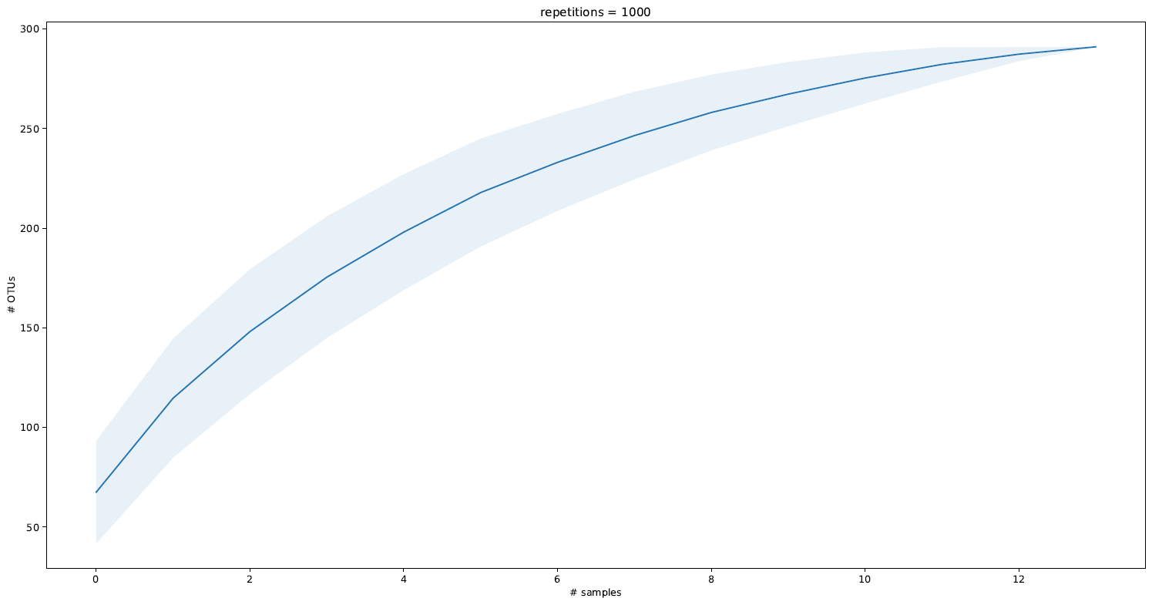
Rarefaction curve
Species richness from the results of sampling
Load the latest TaXon table (TTT_cons_derep_ arthropods_no_NC.xlsx)
Enter the number of repetitions and choose the error bar style
Click on Run
Till-Hendrik Macher
22

Slide 23
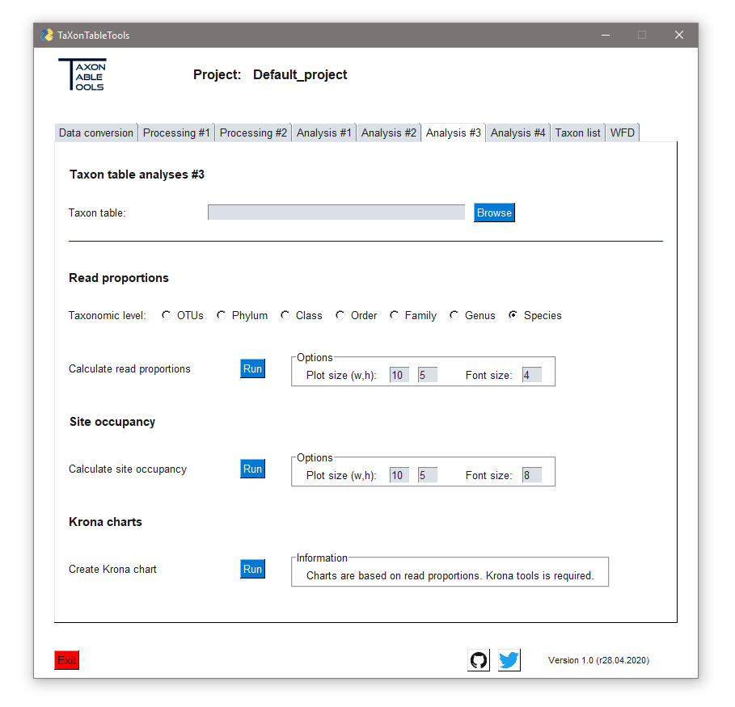
Read proportions
Load the latest TaXon table (TTT_cons_derep_ arthropods_no_NC.xlsx)
Check the taxonomic level to calculate the read proportions (i.e. family)
Adjust the plot size and font size (i.e. 5,5,4)
Click on Run
Here, it is often useful to check the preview until you are happy with the plot visualization
Save the plot
Till-Hendrik Macher
23

Slide 24
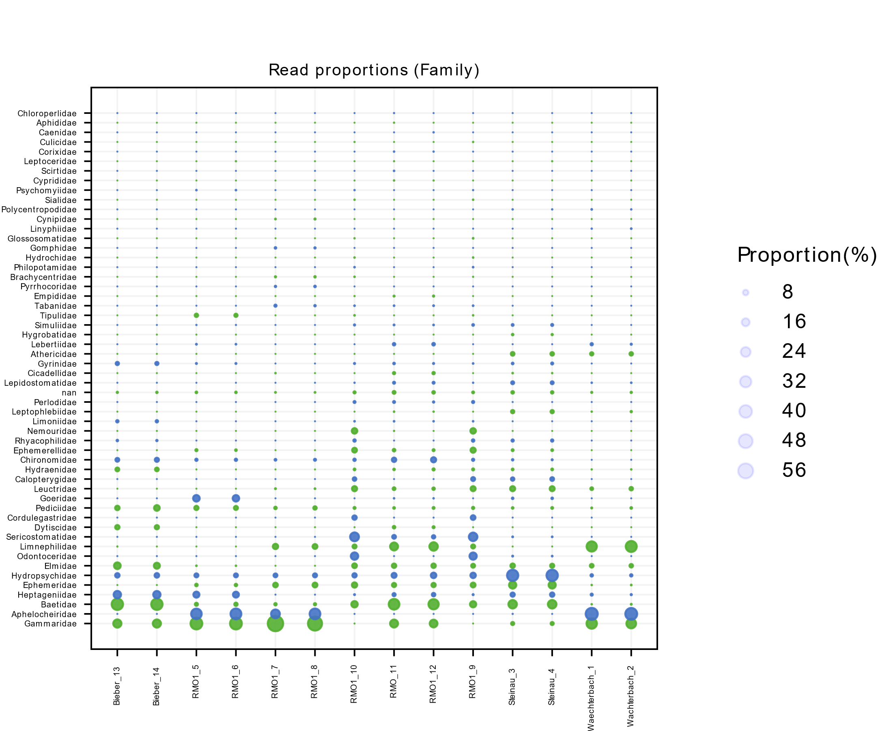
Read proportions
Adjusted plot
Unidentified OTUs
Colors are alternating for better distinction
Scatter sizes reflect the read proportions
Till-Hendrik Macher
24

Slide 25
Metadata table
Creating a new metadata table
Go to the „Processing #2“ tab
Load the latest TaXon table (TTT_cons_derep_ arthropods_no_NC.xlsx)
For more information click on „How does it work?“
To create a new metadata table for the currently active file, click on Run
You don‘t have to load the table seperately when tools require it, as they will be automatically loaded. So do not change the name of the file
The new metadata table is now ready to be adjusted
Till-Hendrik Macher
25

Slide 26
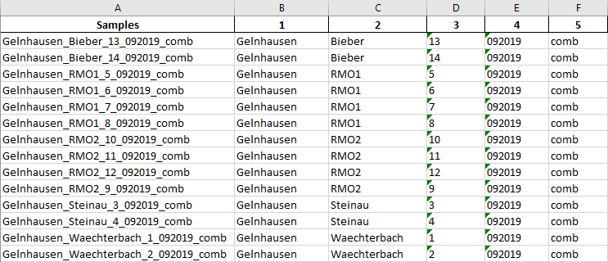
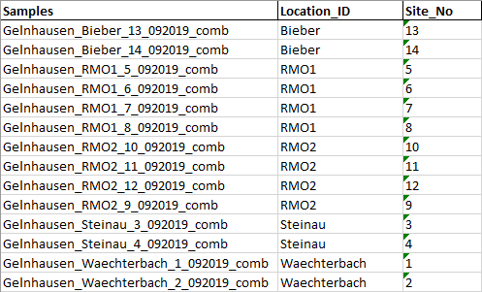
Metadata table
Adjusting the metadata table
Open the metadata table with e.g. Excel
The first column holds the sample names
Never change the names of the samples, as they must be equivalent to the respective TaXon table file
You can re-arrange the order of the samples for a better sorting
The table can hold as columns (=metadata), as the user defines
The standard information is collected from the sample name („_“ as separator)
Now rename the metadata accordingly and delete not-required columns
Name of the metadata
Till-Hendrik Macher
26

Slide 27
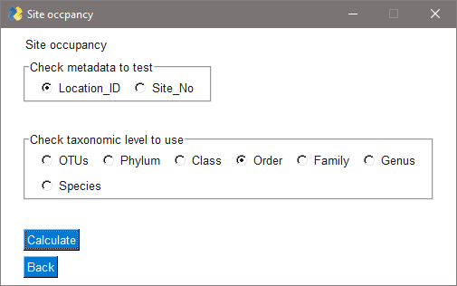
Site occupancy
Load the latest TaXon table (TTT_cons_derep_ arthropods_no_NC.xlsx)
Remember: This TaXon table now has an according metadata table
A new window will pop up and ask for additional information
In this case we choose the „Location_ID“ as metadata and „Order“ as taxonomic level
The site occupancy will be calculated and the last (!) plot will be shown and all (!) plots will be saved
Till-Hendrik Macher
27

Slide 28
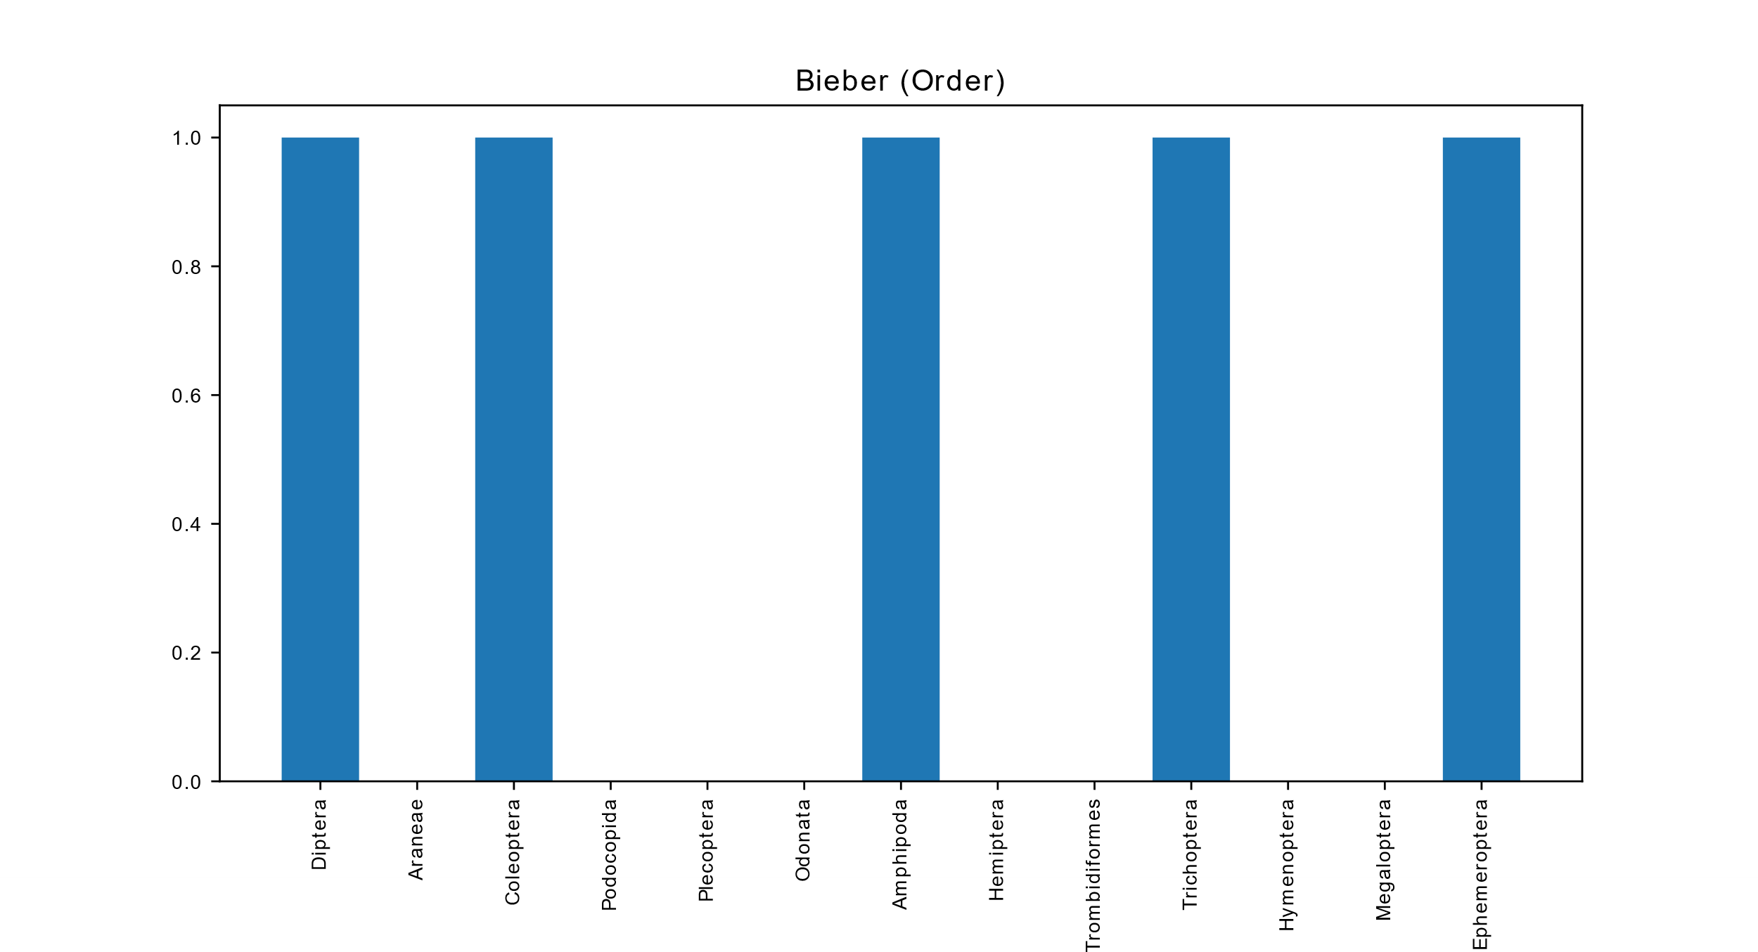
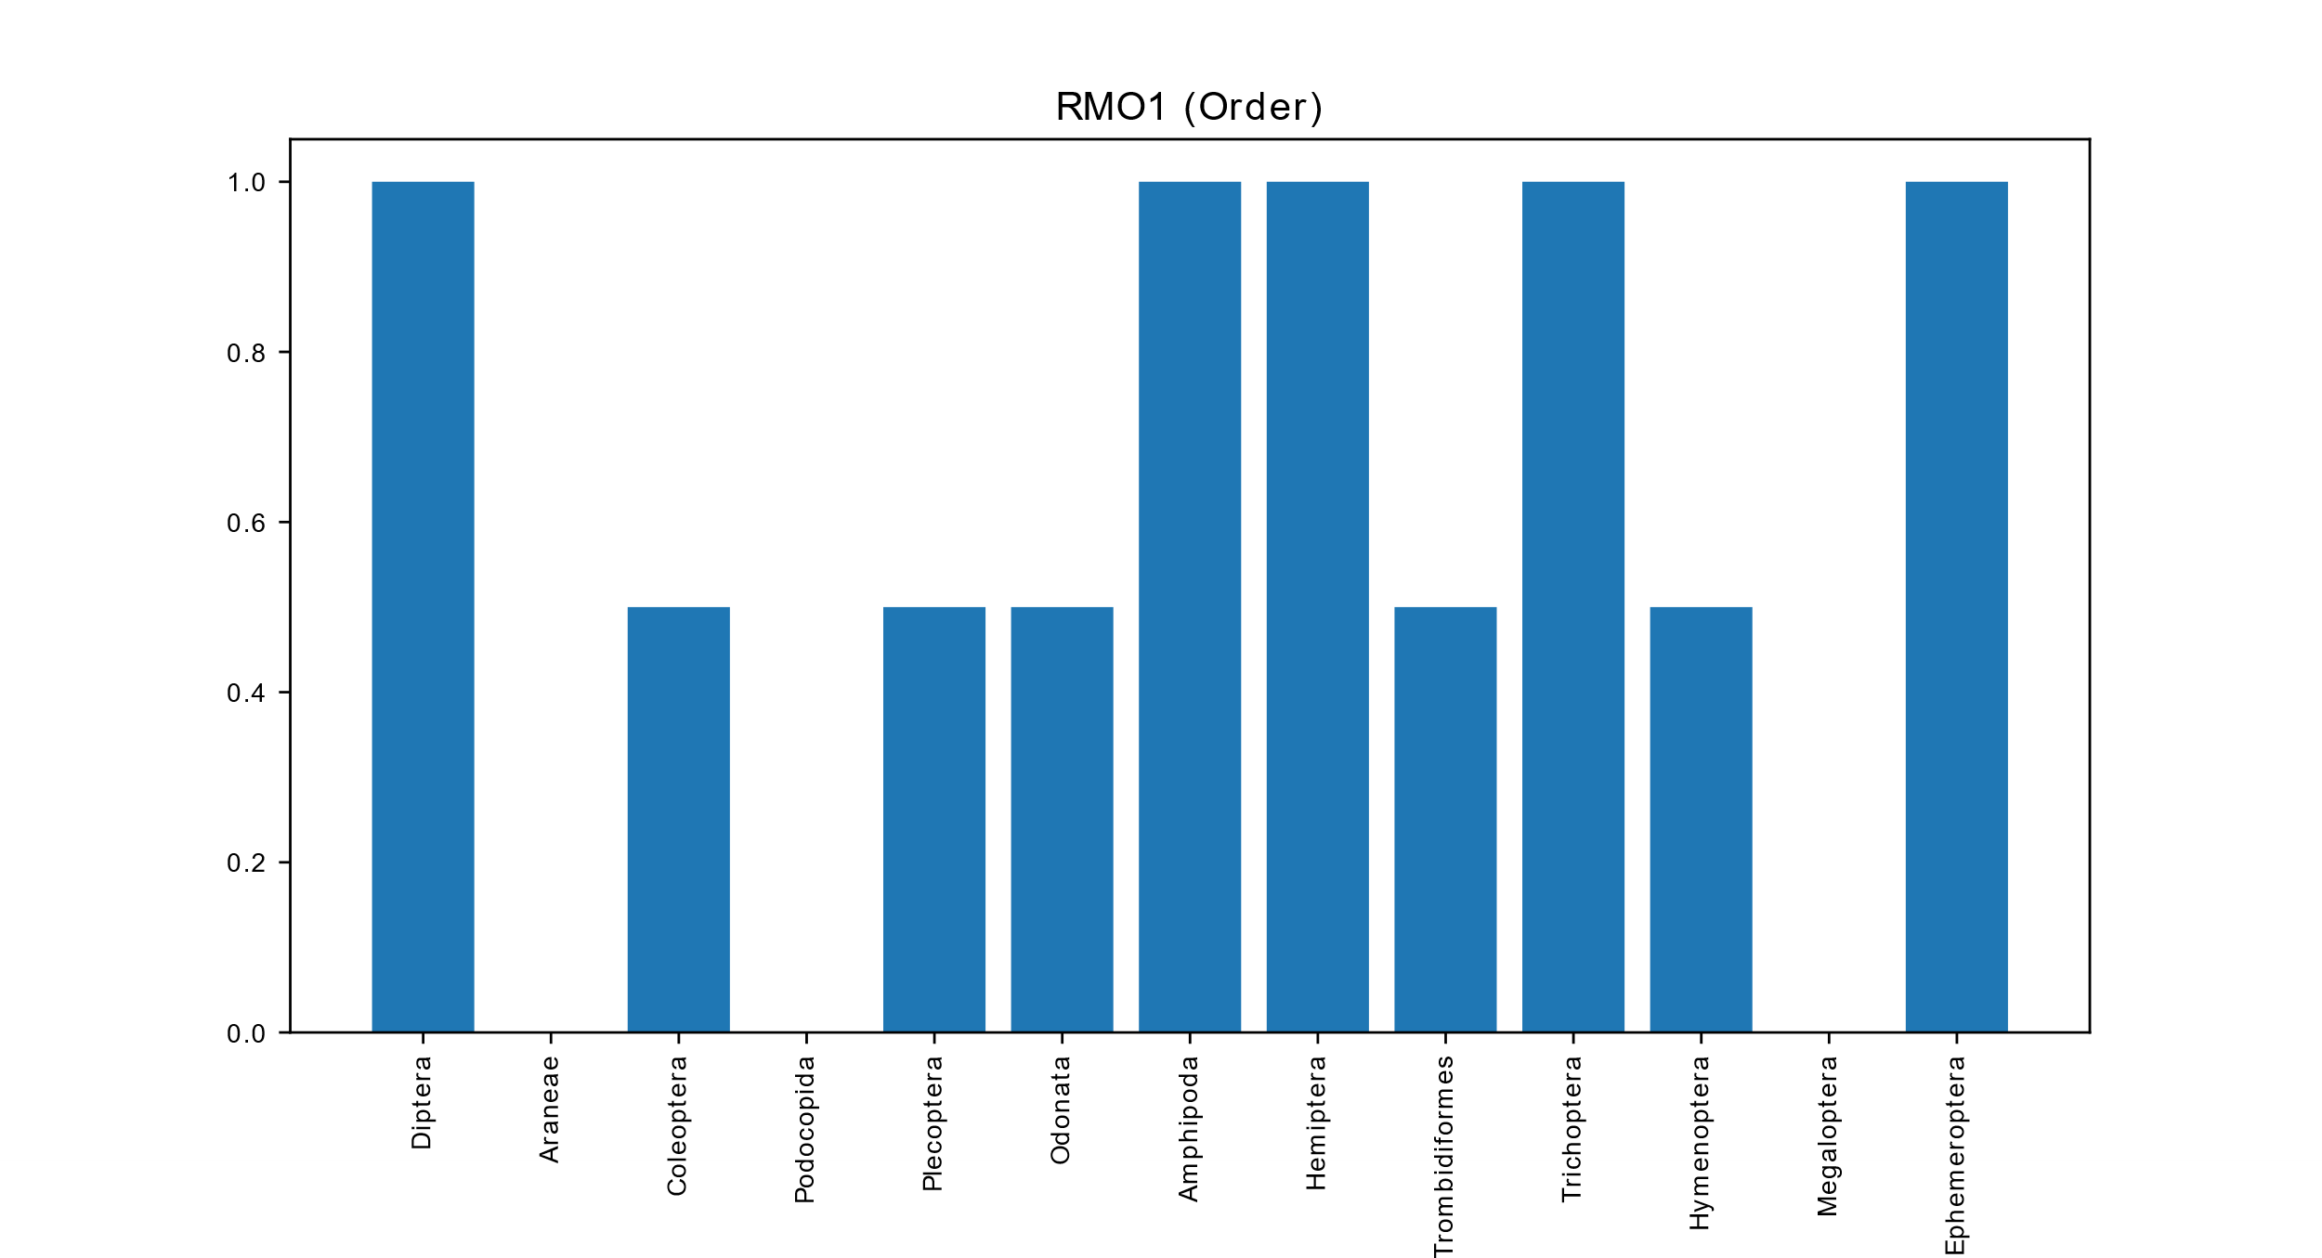
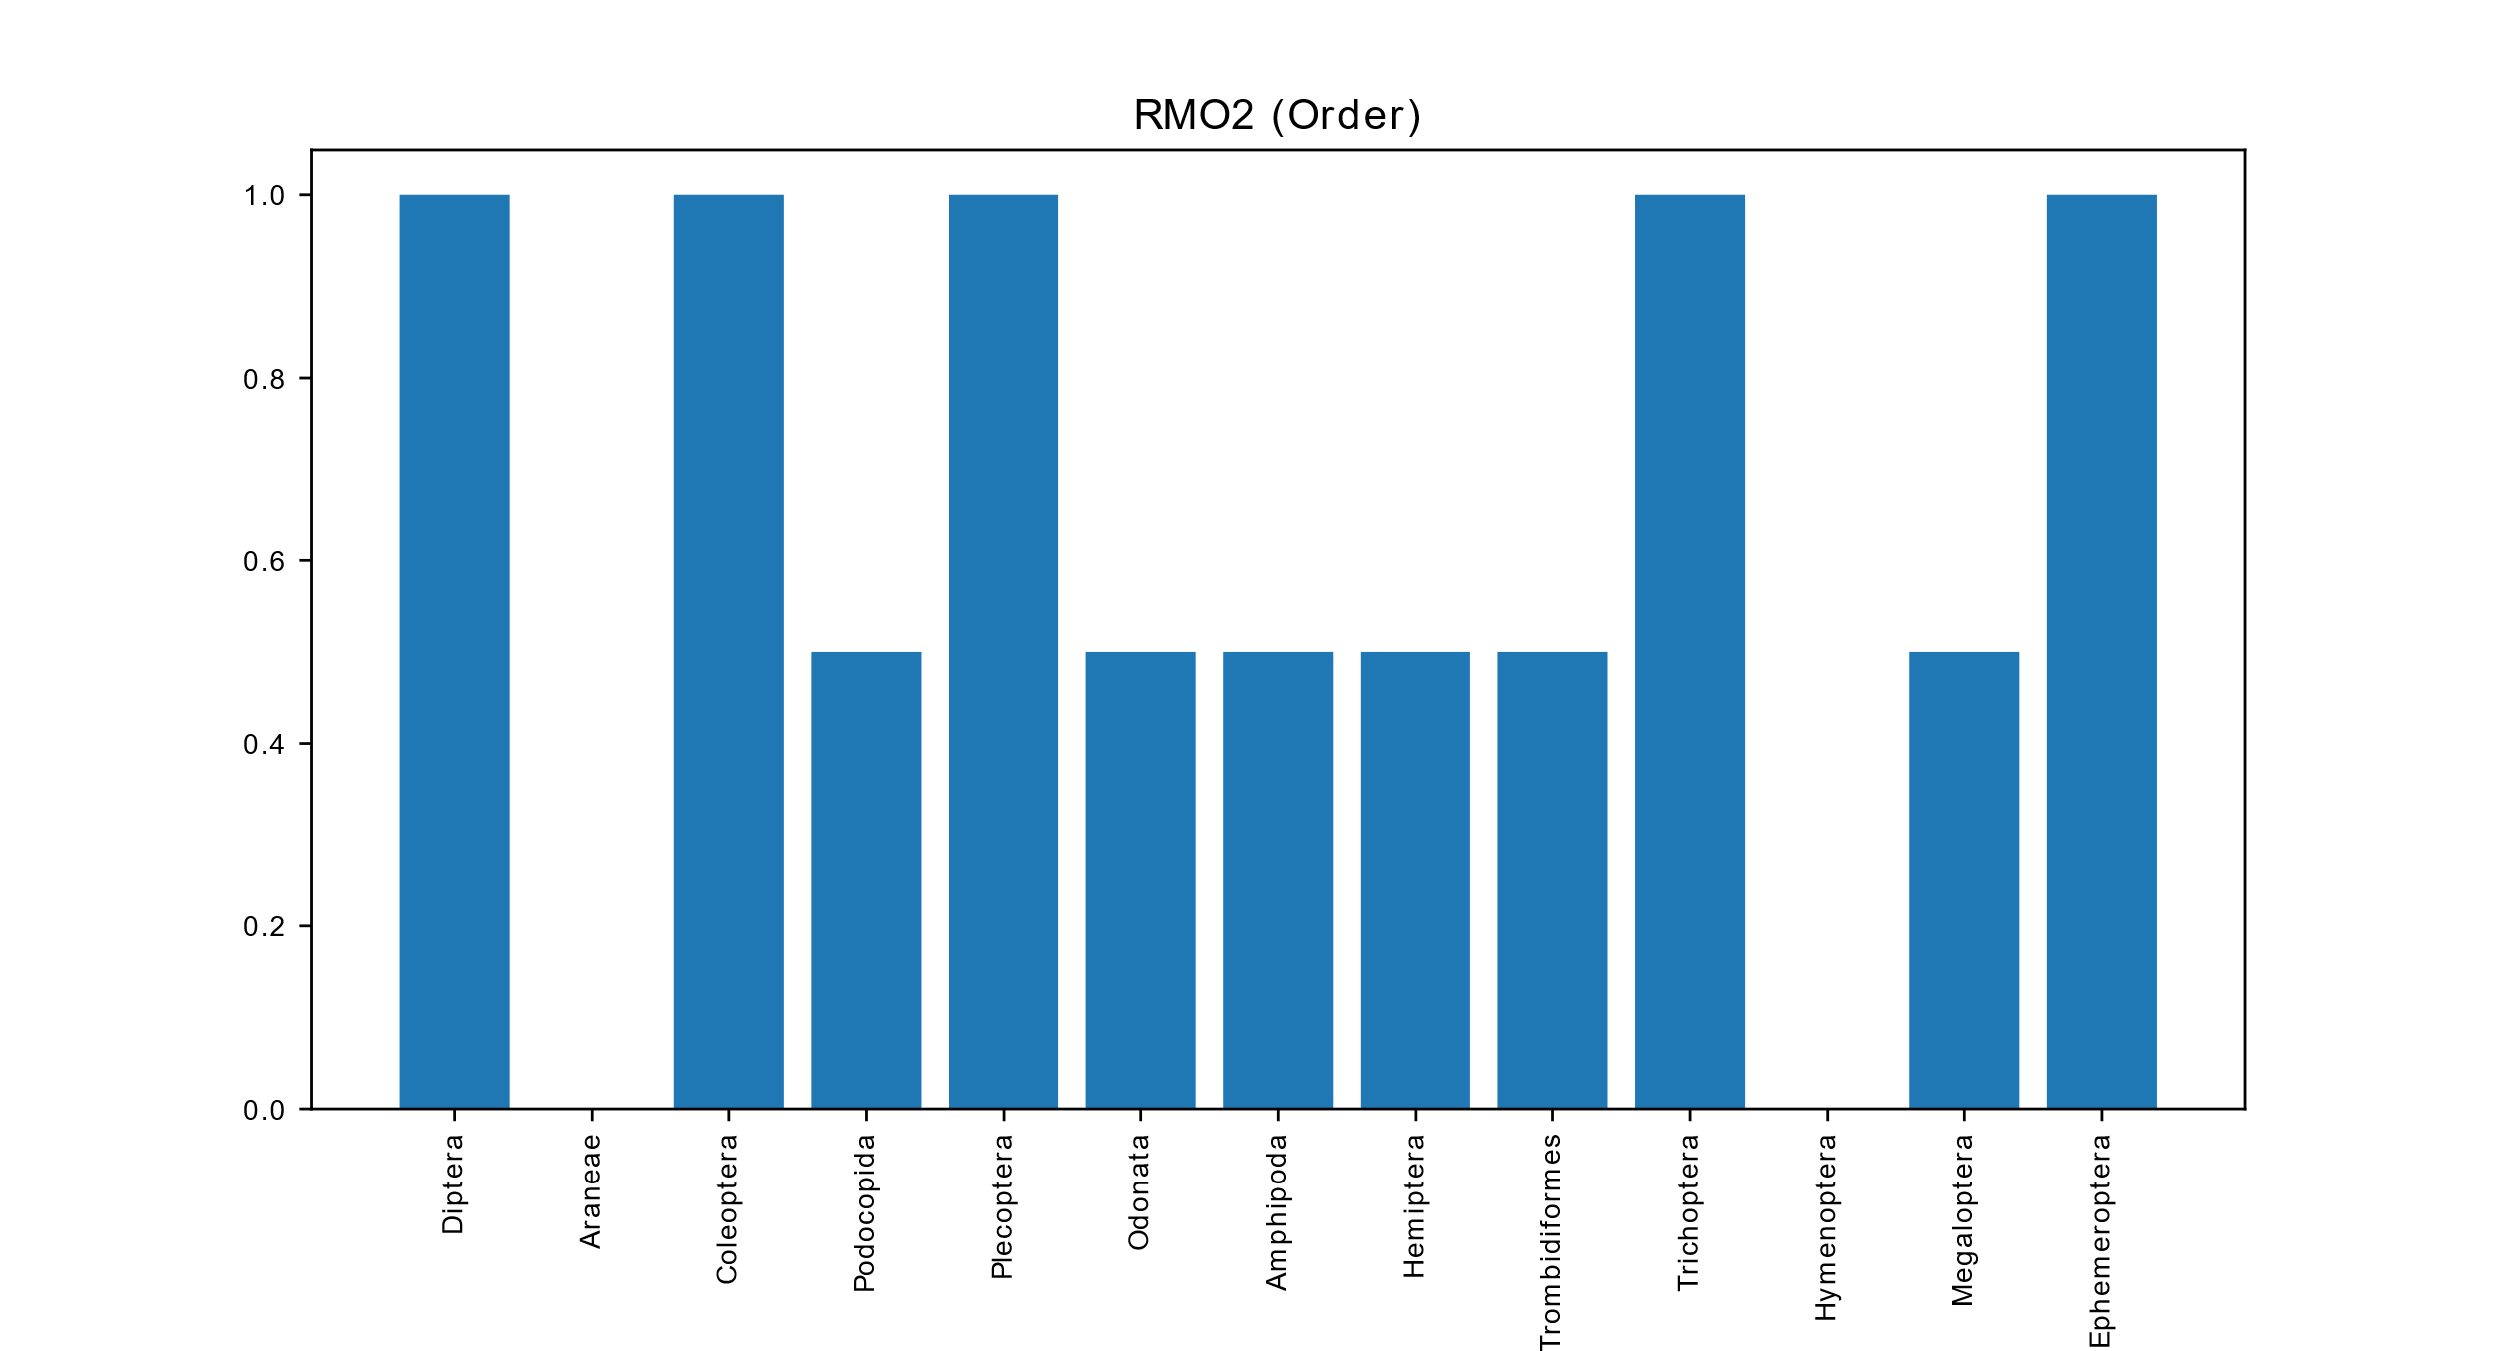
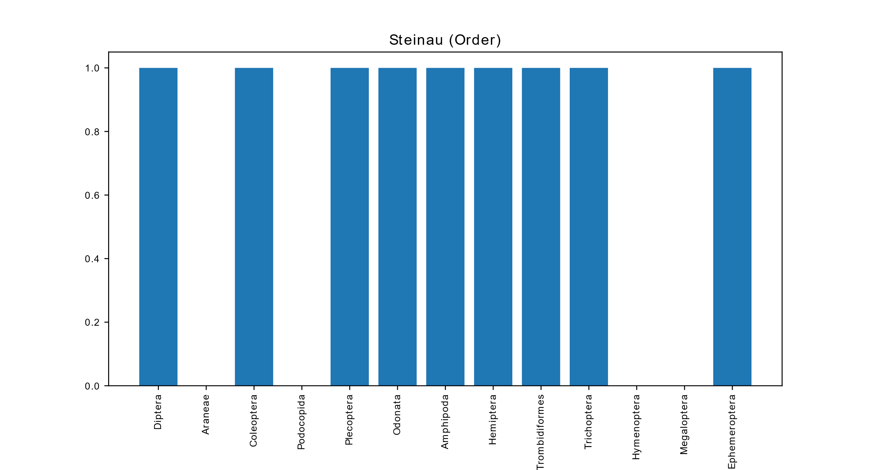
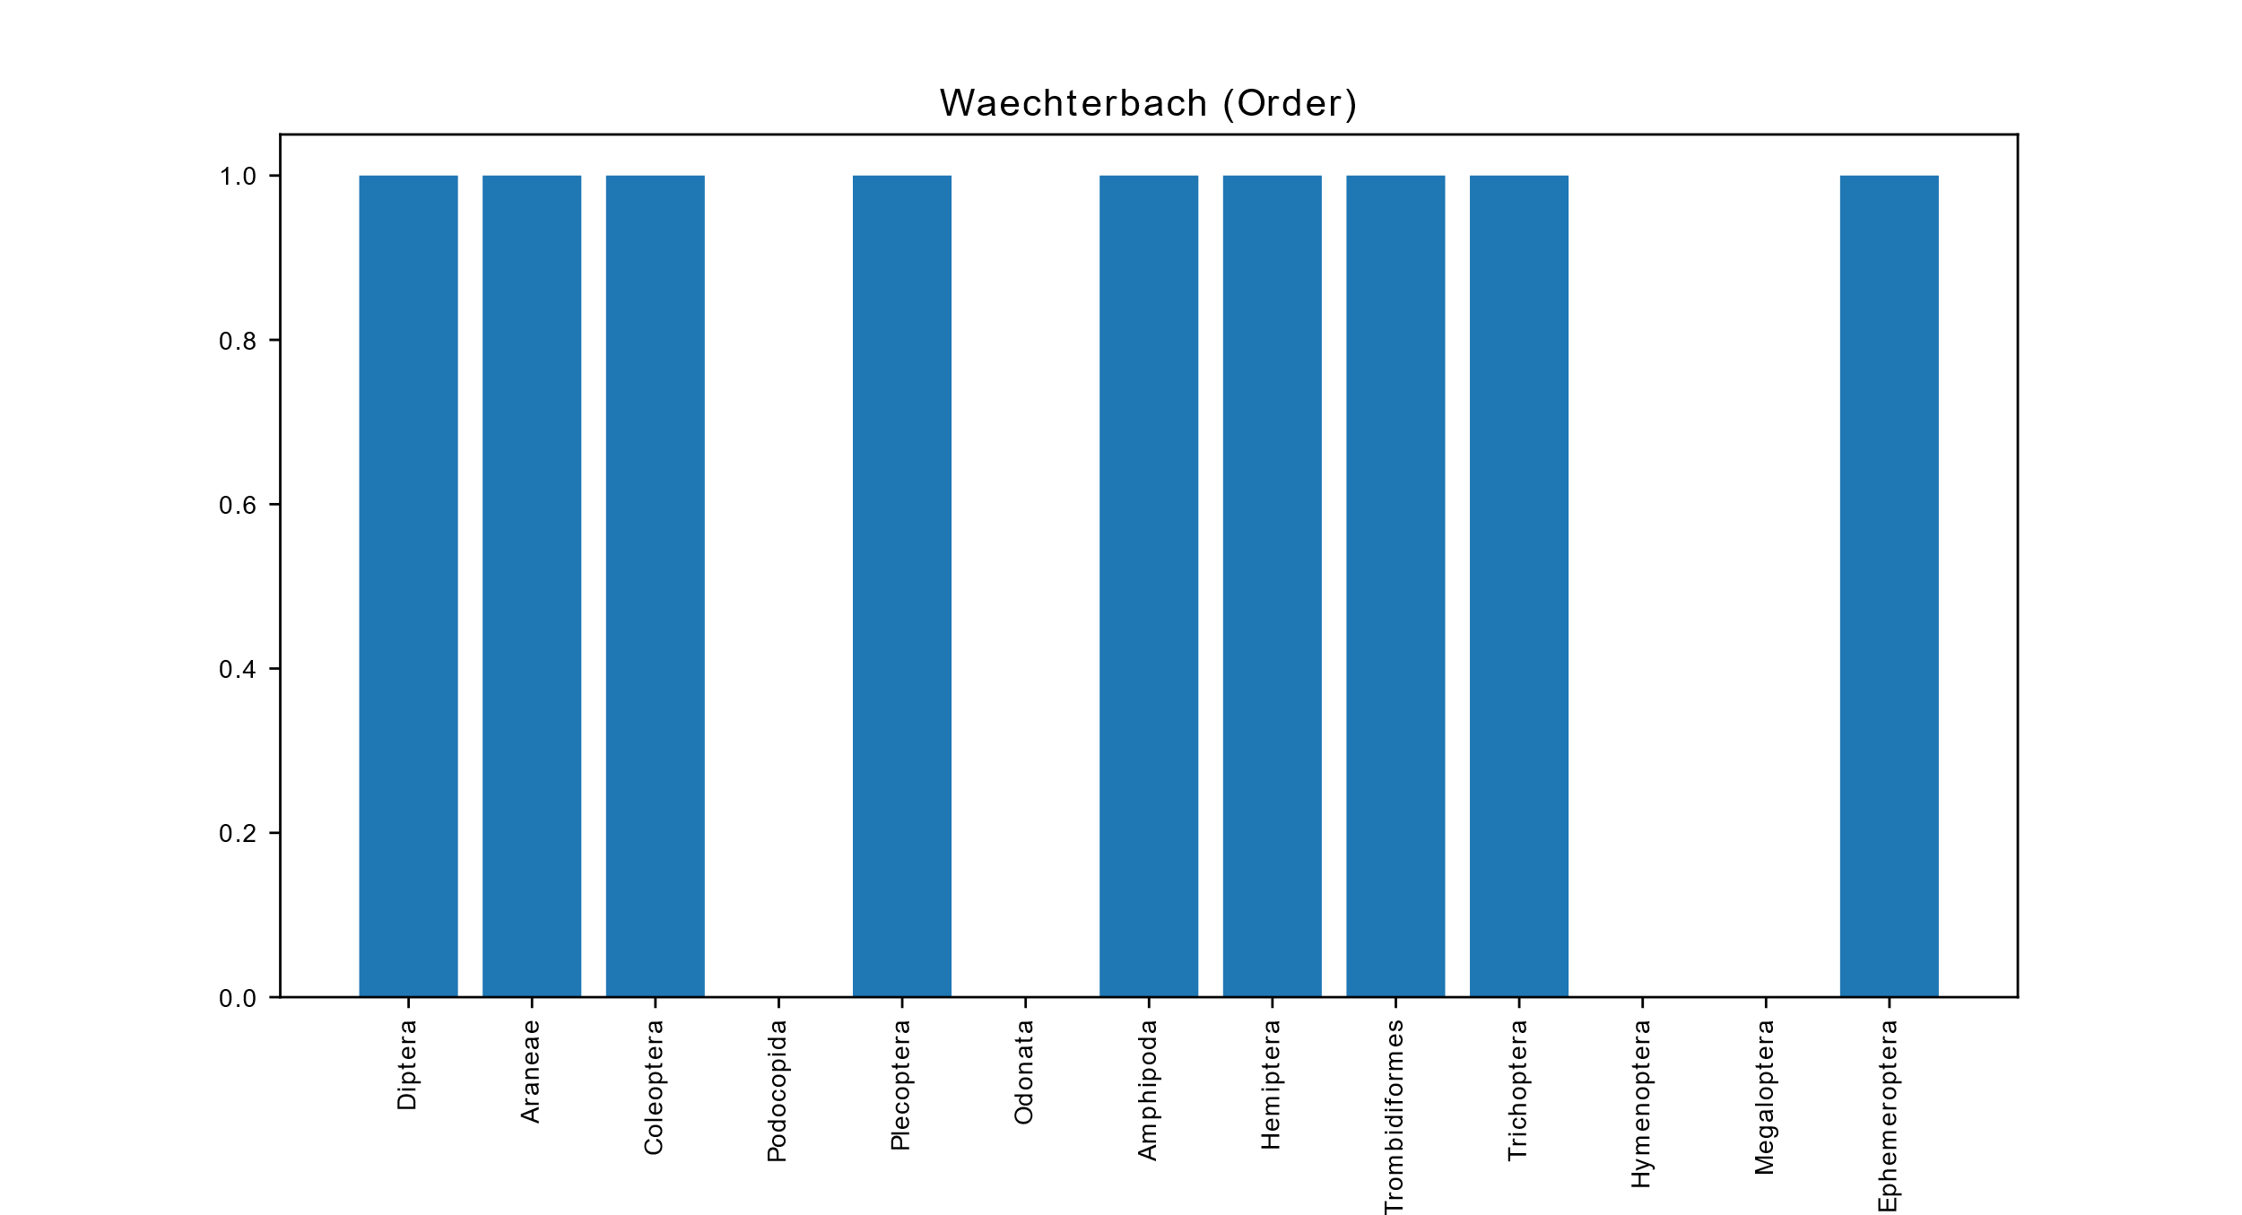





Site occupancy
Each metadata (here: sampling site) was saved as an individual plot
The x-axis shows the occupancy, ranging from 0 (present in none of the samples) to 1 (present in all of the samples)
Note: despite its name, this tool is not limited to calculate the occupancy of a sampling site, but rather the taxon occupancy of any given metadata
Till-Hendrik Macher
28

Slide 29
Krona charts
Note: Krona tools is currently not available for Windows
Load the latest TaXon table (TTT_cons_derep_ arthropods_no_NC.xlsx)
Click on Run
The newly created Krona chart will be saved as html file
The illustrated proportions are relative read abundances
Open the file with any Browser (e.g. Chrome or Firefox)
This interactive chart allows the user to zoom in to specific taxonomic level
Till-Hendrik Macher
29

Slide 30
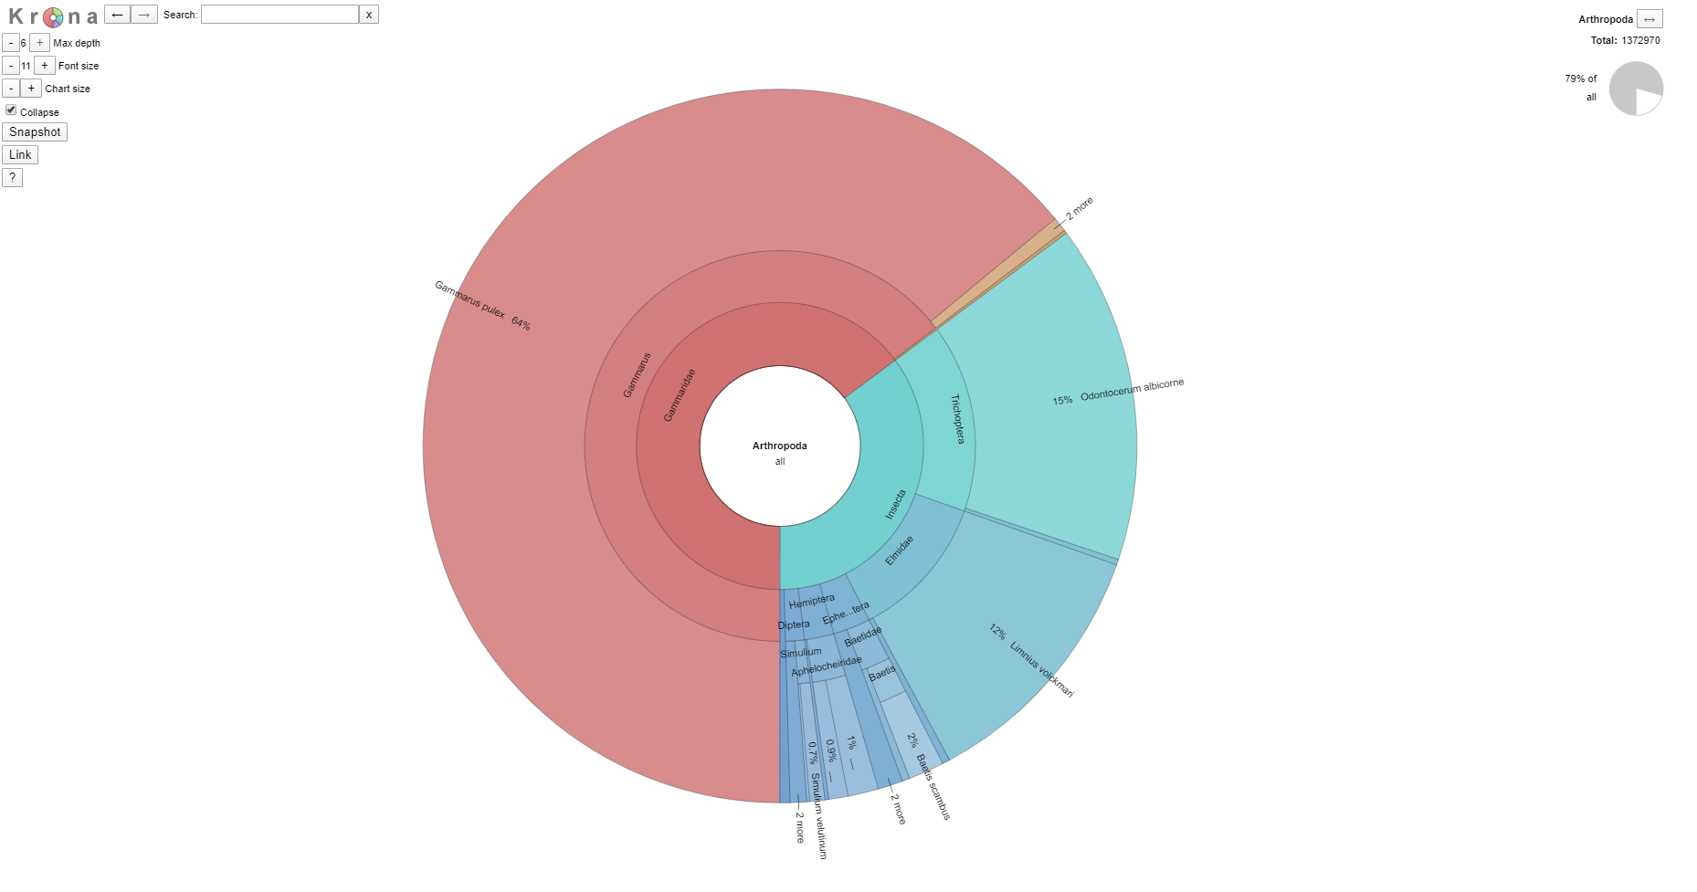
Krona charts
Save the Krona chart as svg
Interactive pie chart
Till-Hendrik Macher
30

Slide 31
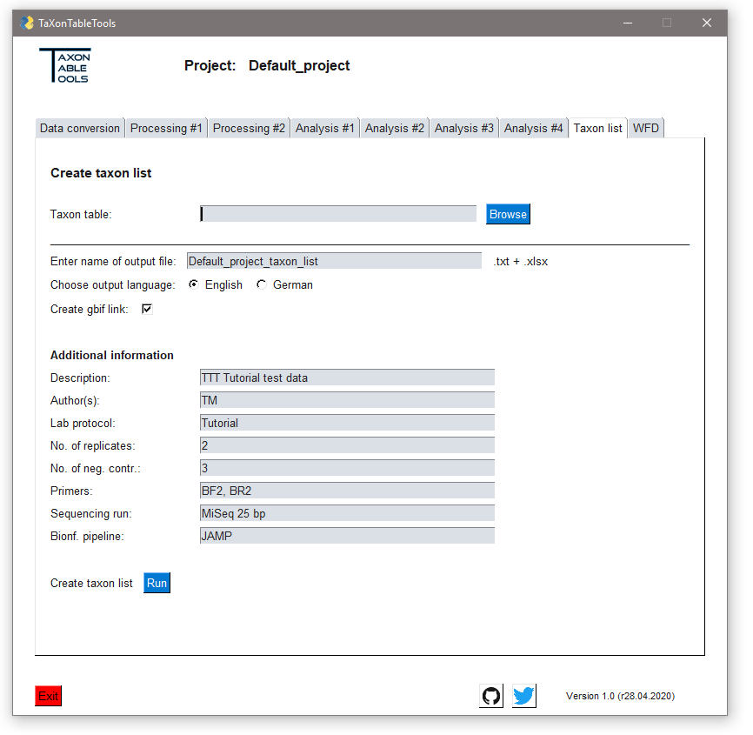
Taxon list
Load the latest TaXon table (TTT_cons_derep_ arthropods_no_NC.xlsx)
Enter the name of the output file
Choose language
Leave the GBIF link check mark
This requires an acitve internet connection
For all species-level identified OTUs, a link to the respective GBIF site will be created
Enter the additional information as needed (can also be left blank)
Click on Run
Till-Hendrik Macher
31

Slide 32
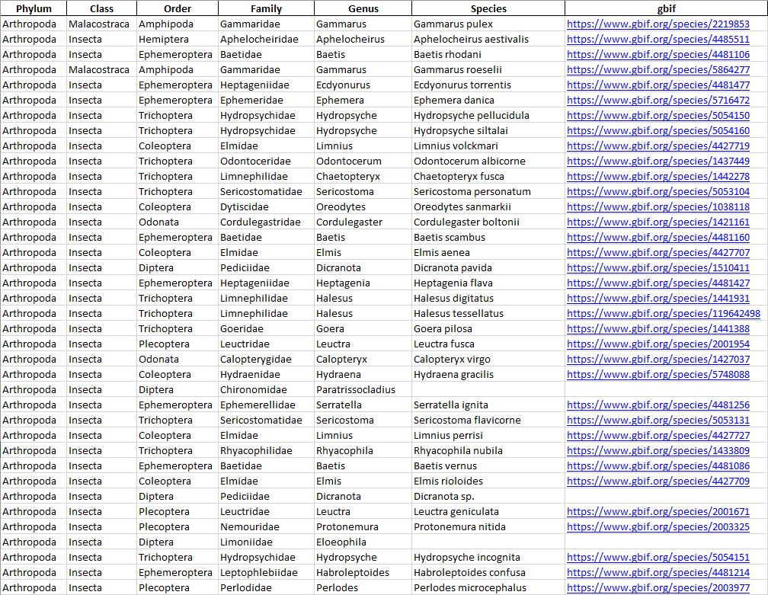
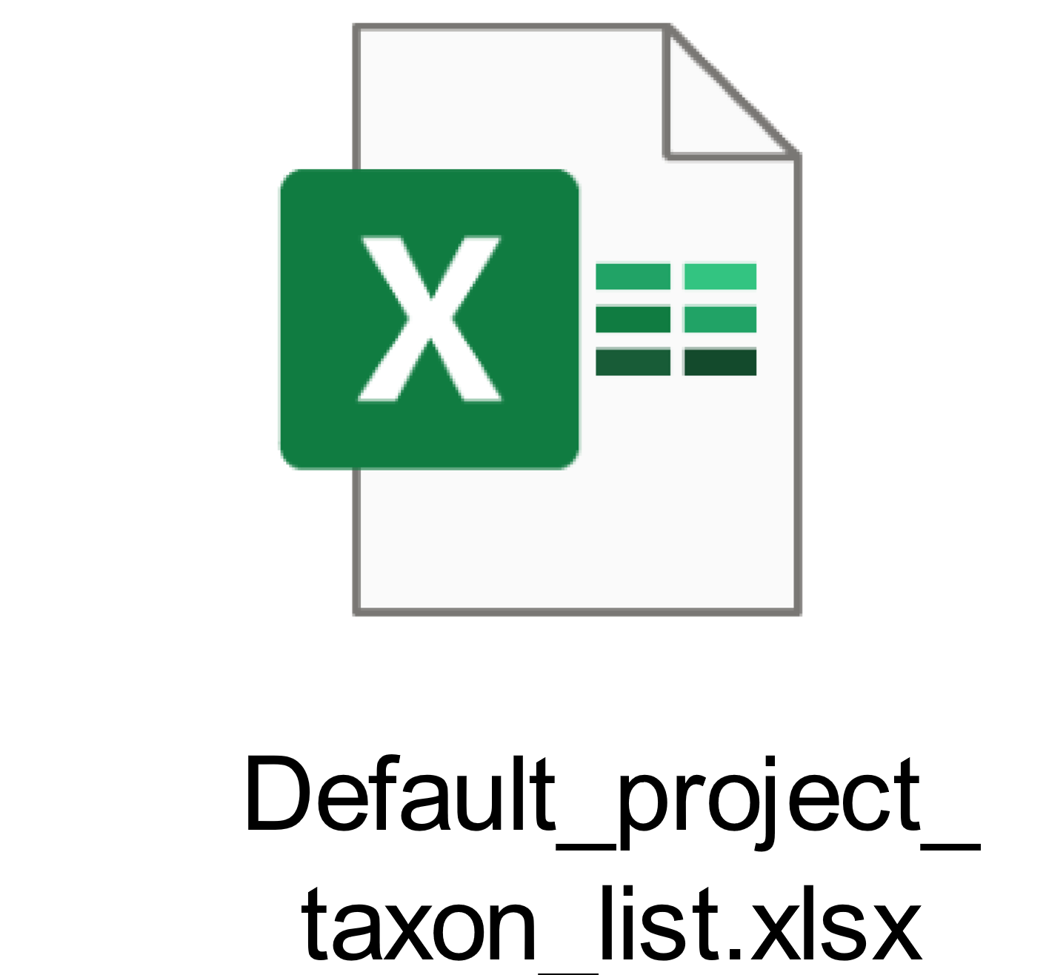
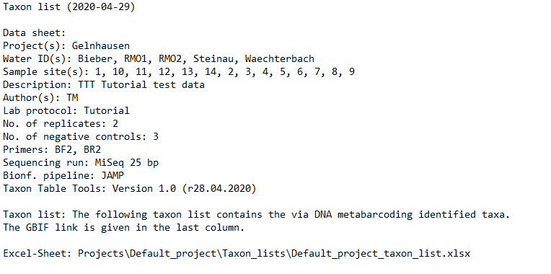
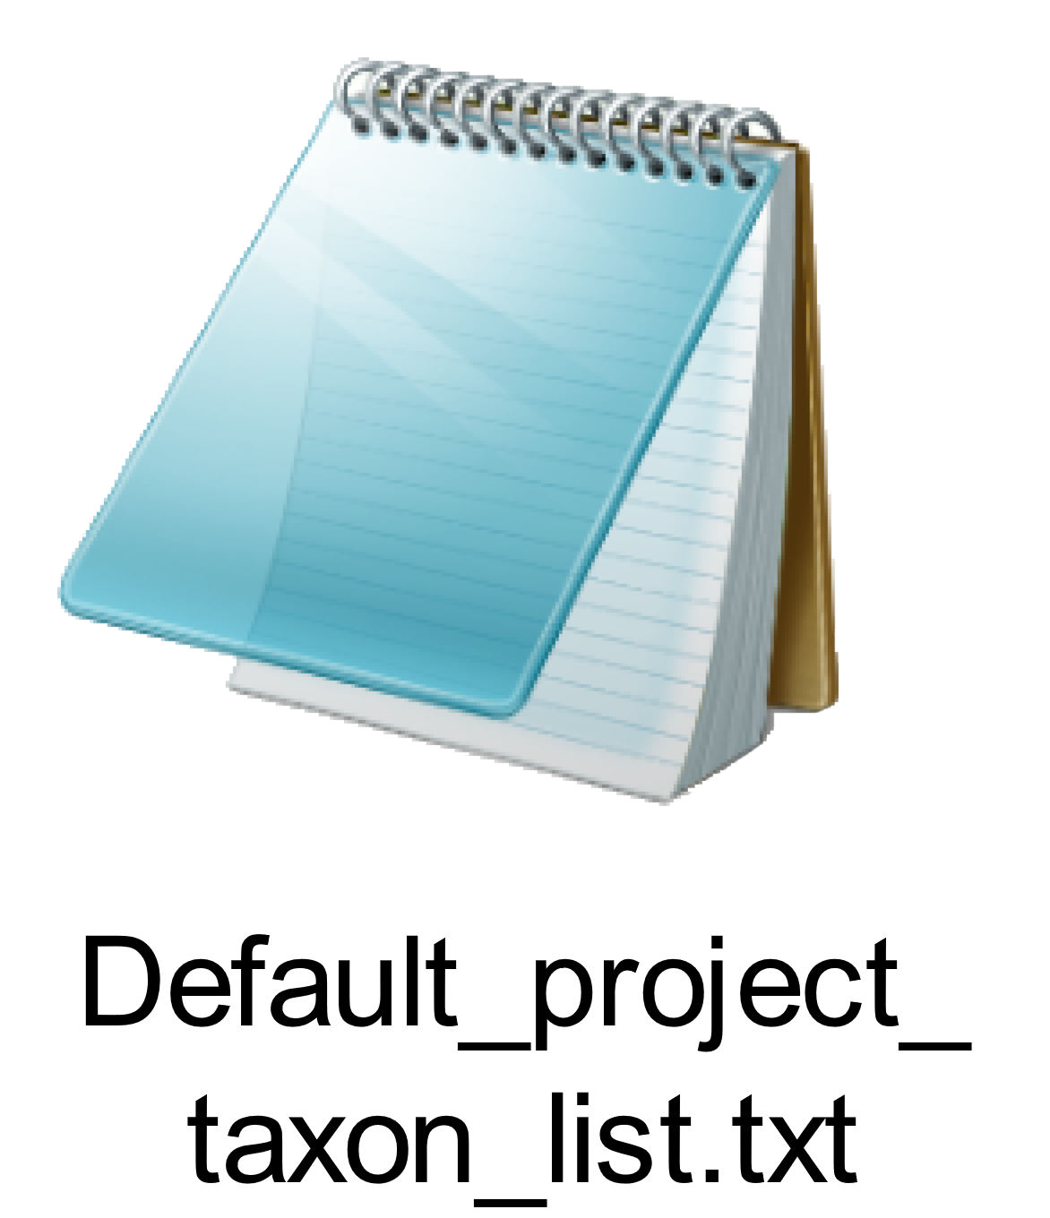
Taxon list
Link to the gbif database
Taxonomic information
Location of the taxon list
Till-Hendrik Macher
32

